Slide 1


Slide 2
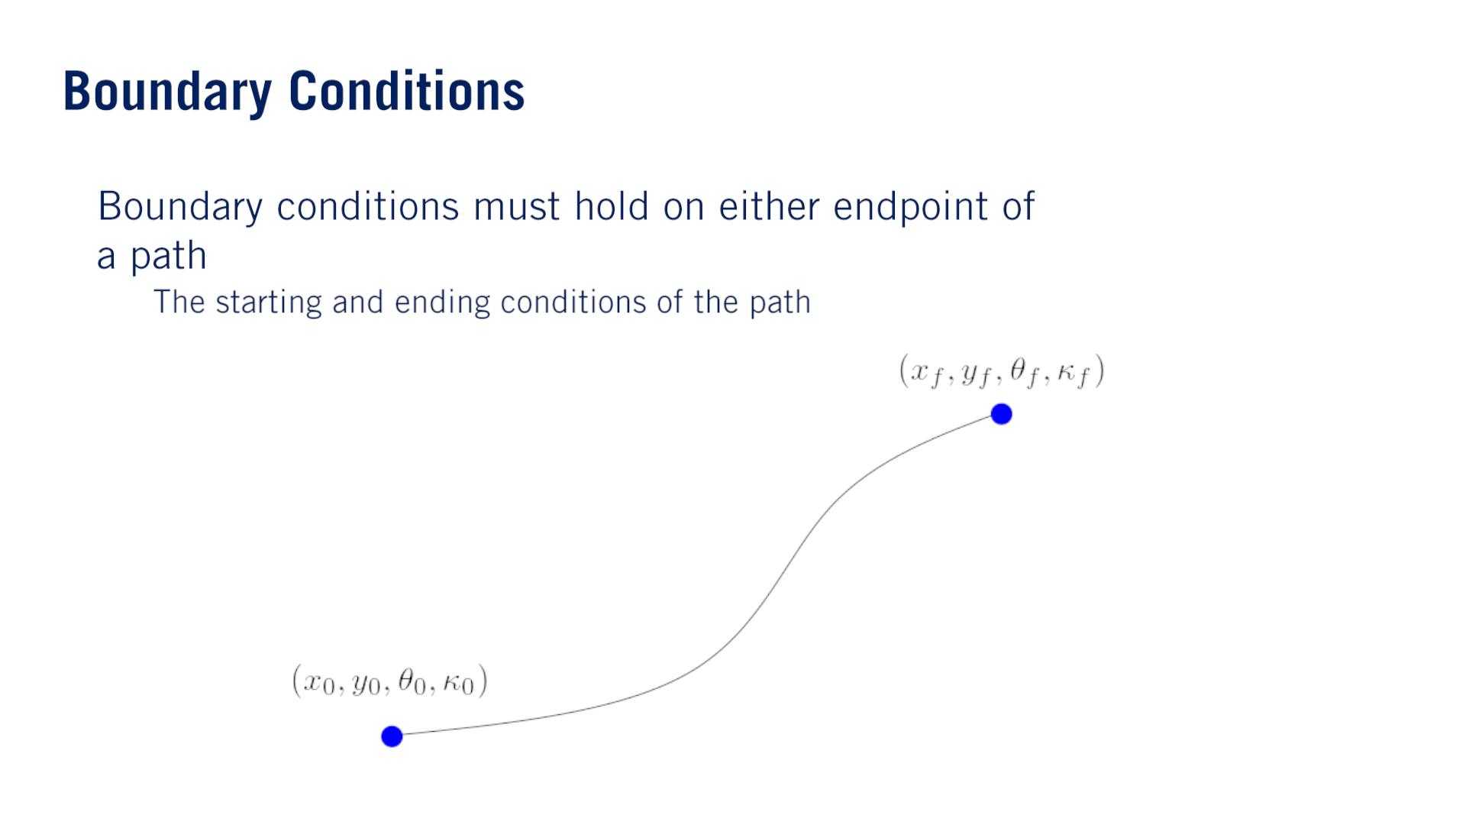
•
o
In the context of an optimization, the starting and end values can be formulated as the boundary conditions of the problem, and the kinematic motion of the vehicle can be formulated as continuous time constraints on the optimization variables.

Slide 3
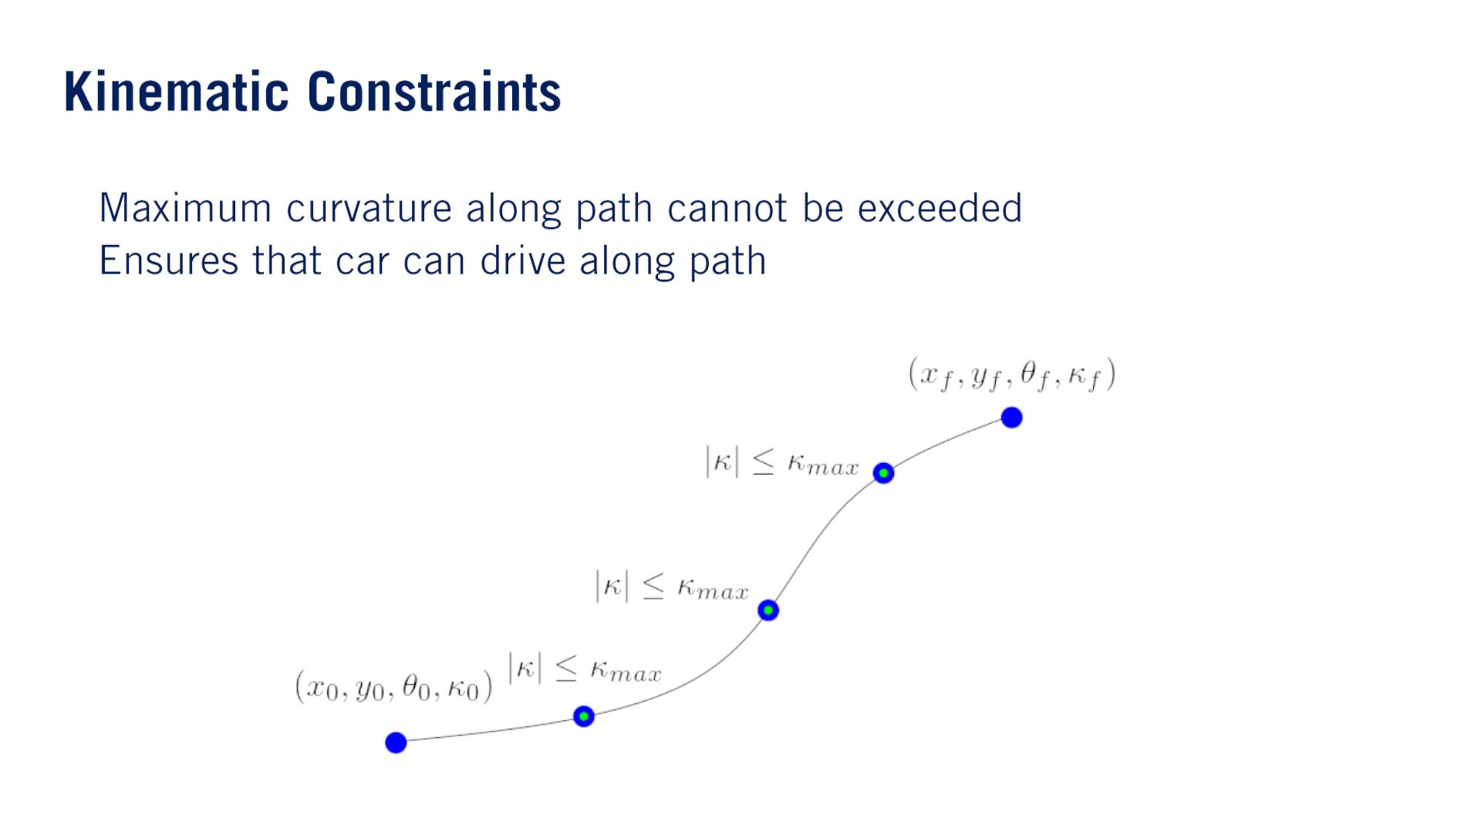
In general, this is not easy to satisfy since there are infinitely many points along a continuous path. Instead, we will often take samples of the curvature at different points along the path, and constrain the curvature of each of these points. Assuming the path is relatively well-behaved, this will likely correspond to the curvature of the entire path satisfying the constraint.
•
•

Slide 4
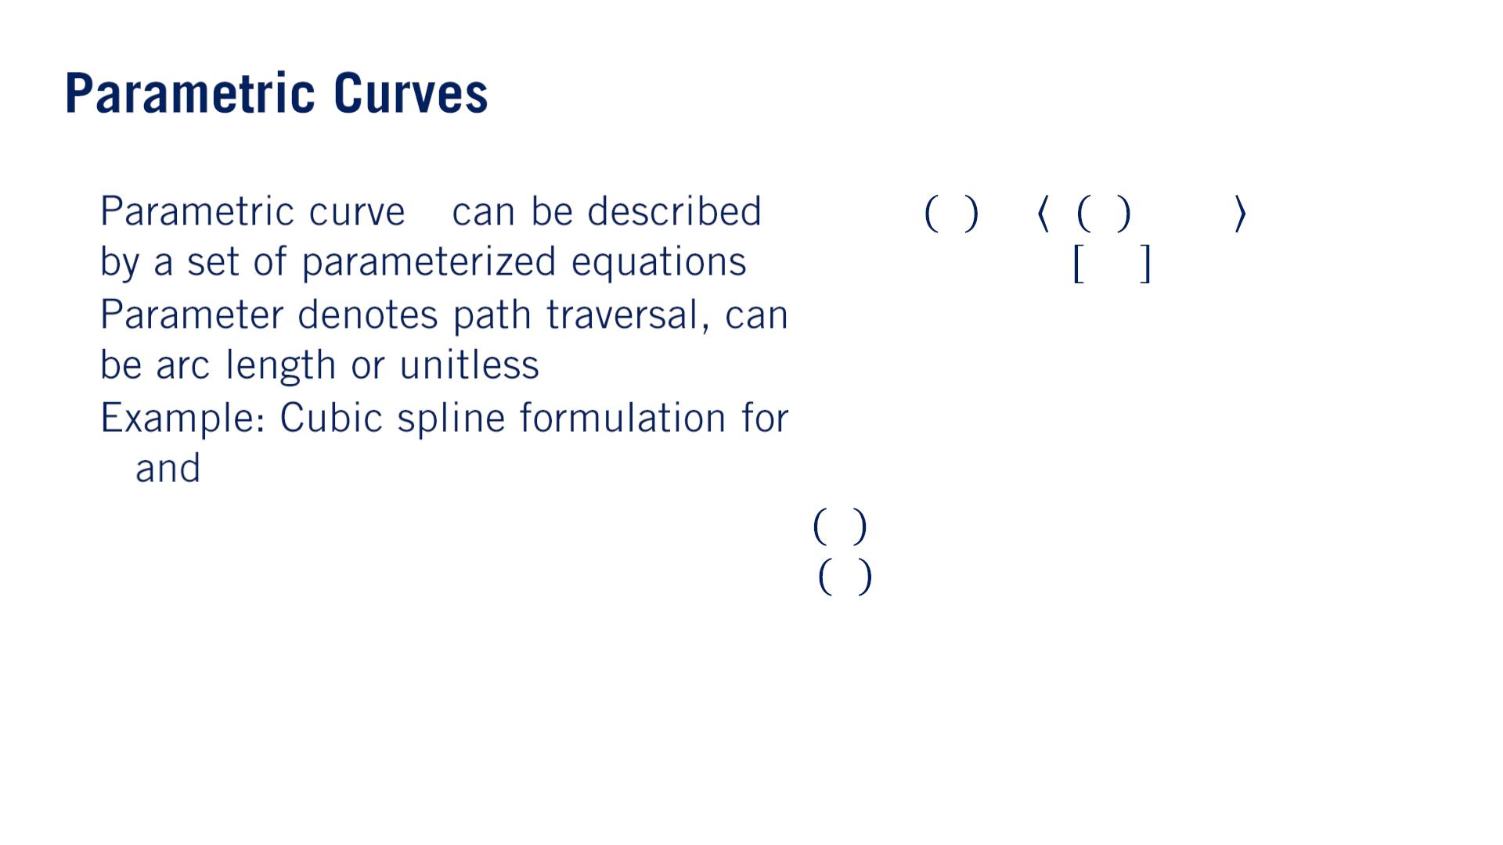
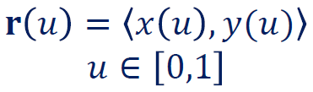
•
•
•
퐫
푥 푦
3
2
2
푥 푢 = 훼 푢 + 훼 푢 + 훼 푢 + 훼
3
2
1
0
3
푦 푢 = 훽 푢 + 훽 푢 + 훽 푢 + 훽
3
2
1
0

Slide 5
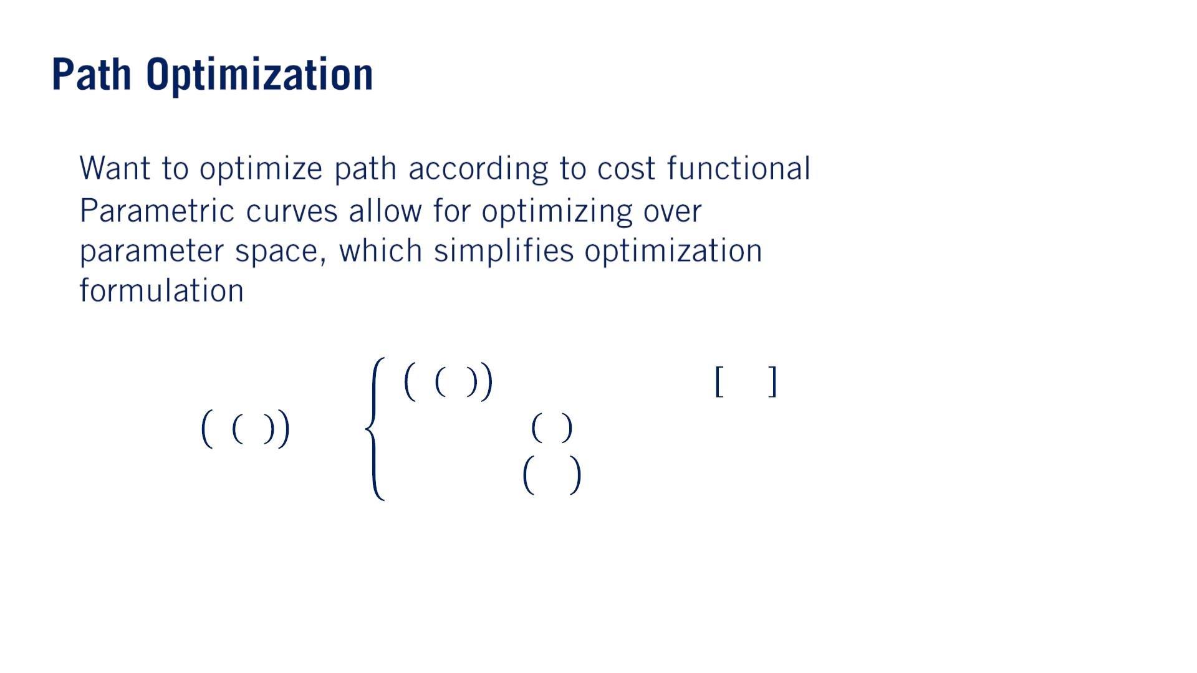
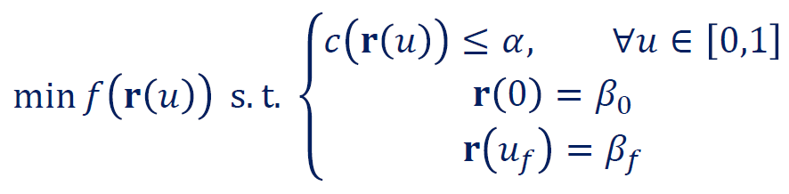
•
•
푓
Curvature
Note that the term functional refers to mappings that takes a function as their argument and return a real value.

Slide 6
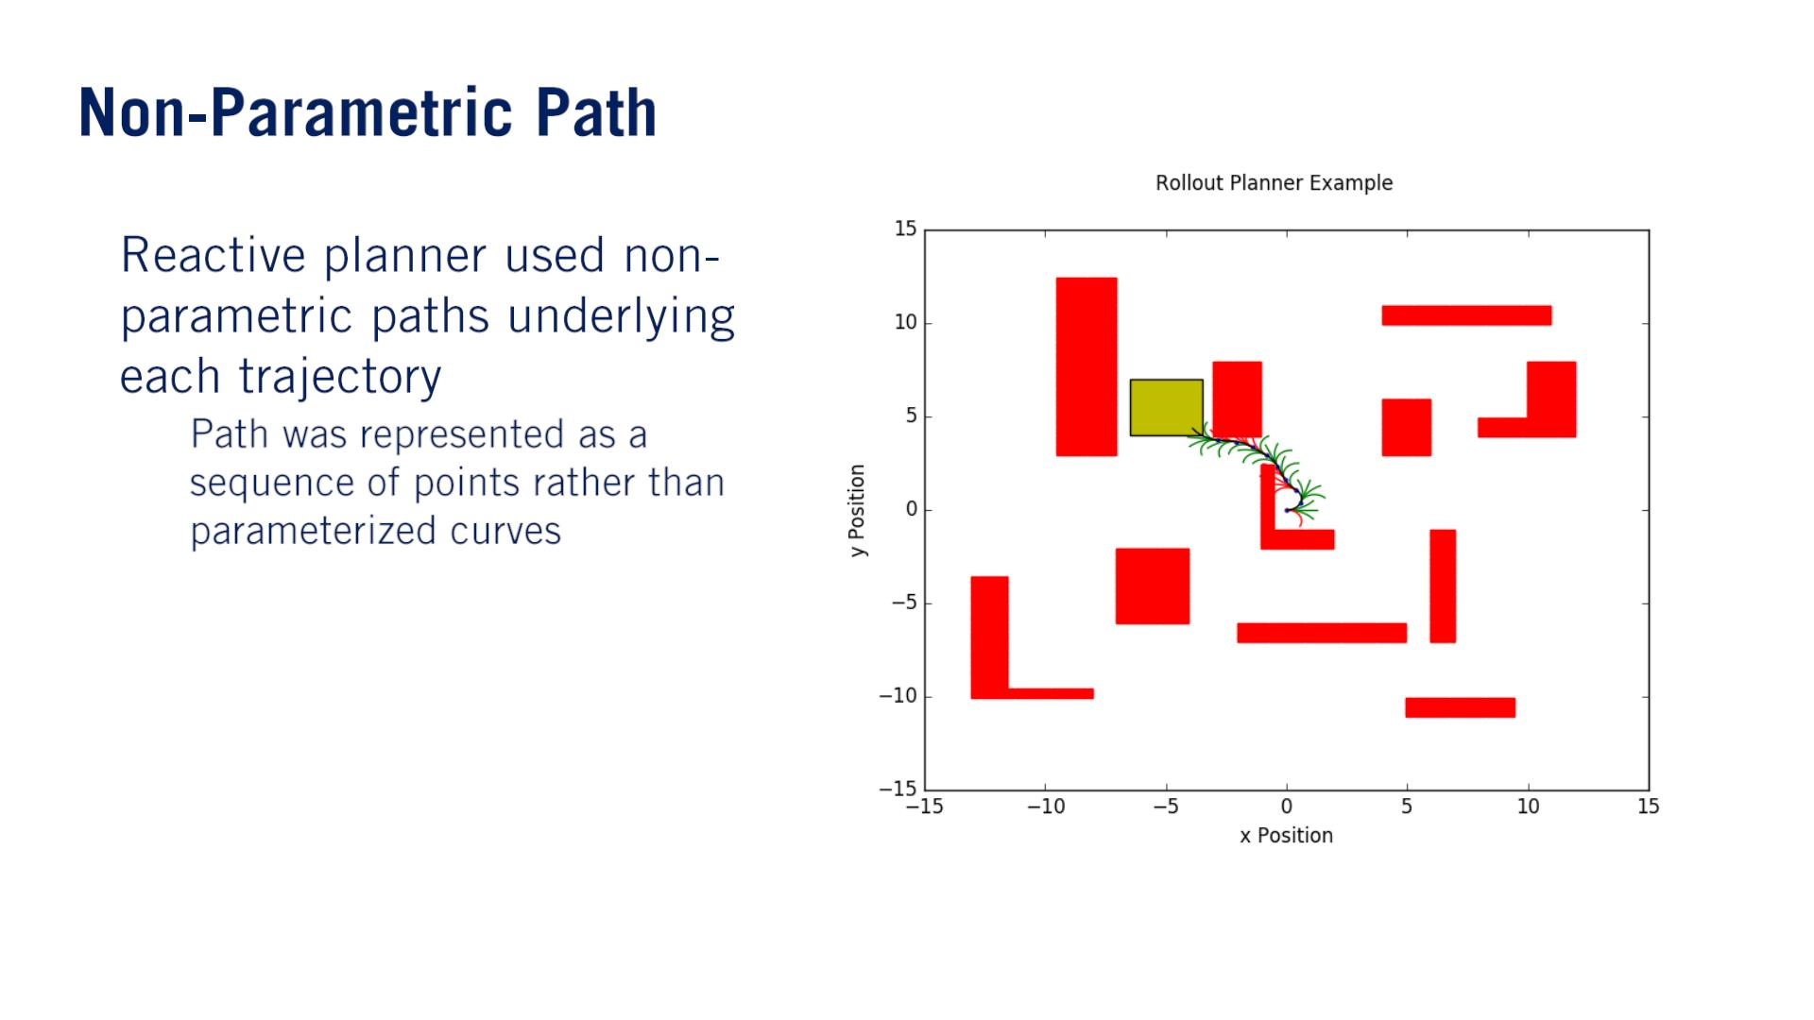
•
o
Parametric pathとNon-parametric pathの区別は点列になっているかではなく、点列がparametric curveかnon-parametric curveから取られたかのことだと思う。

Slide 7
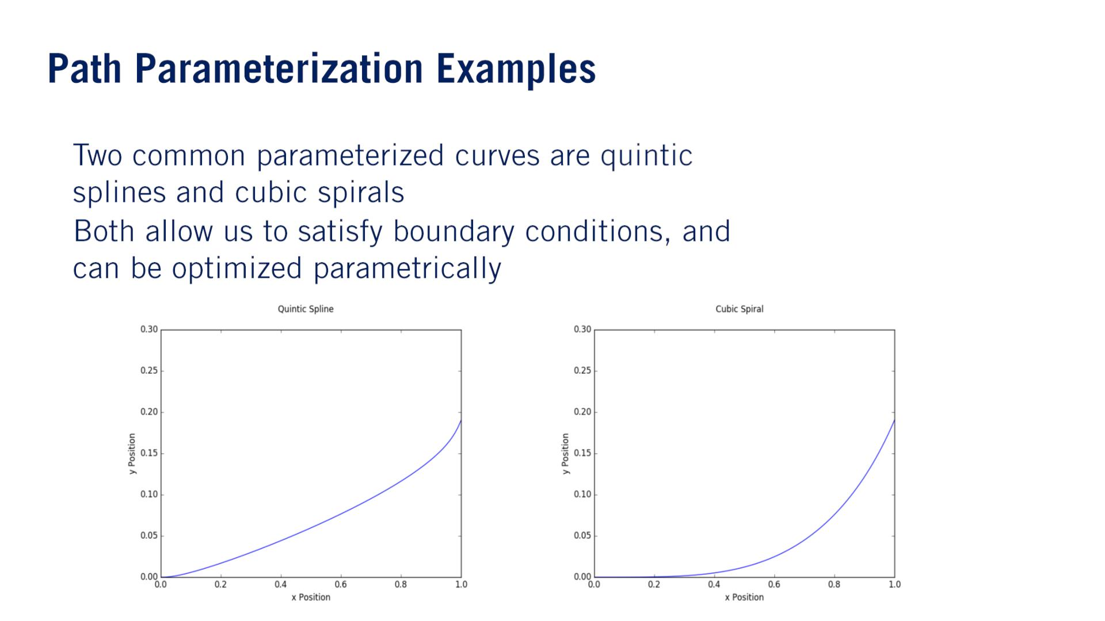
五次の
•
•

Slide 8
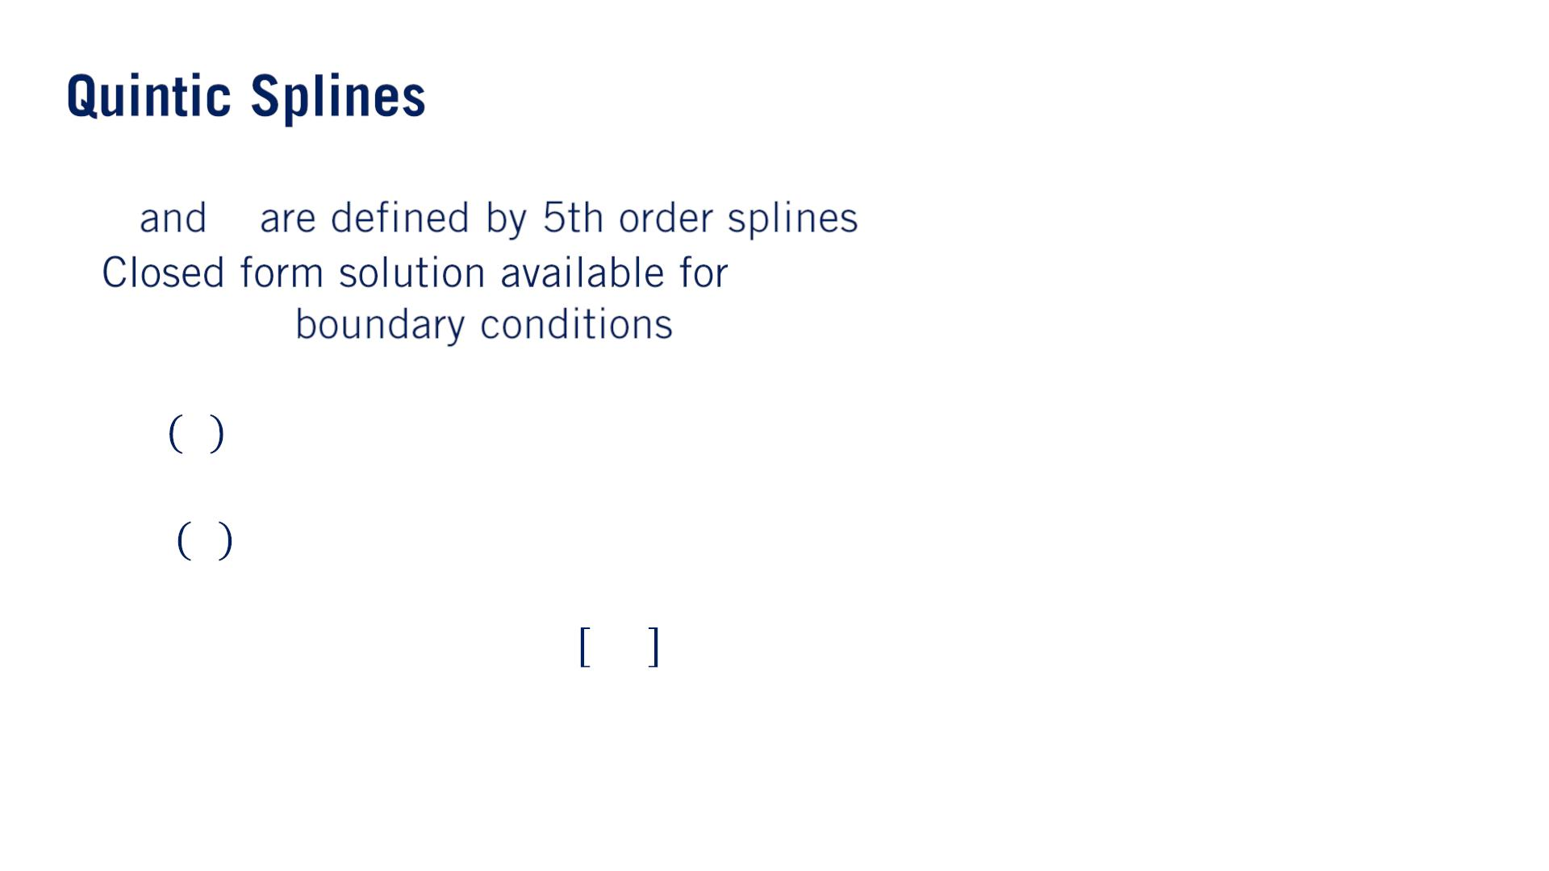
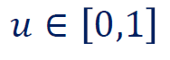
• 푥 푦
•
The solution is quite long so we won’t list here, but it is still cheaper to evaluate than generating a path using an iterative optimization method.
(푥, 푦, 휃, 휅)
5
4
4
3
3
2
2
푥 푢 = 훼 푢 + 훼 푢 + 훼 푢 + 훼 푢 + 훼 푢 + 훼
5
4
3
2
1
0
5
푦 푢 = 훽 푢 + 훽 푢 + 훽 푢 + 훽 푢 + 훽 푢 + 훽
5
4
3
2
1
0

Slide 9
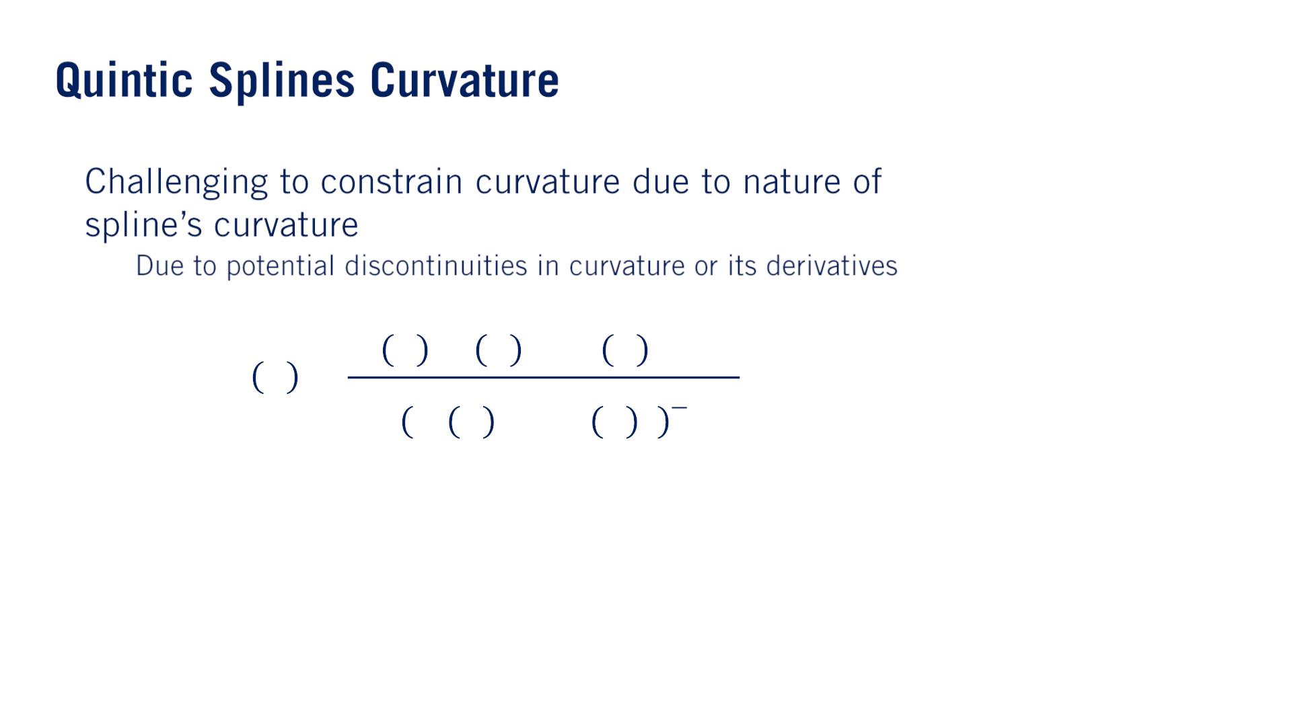
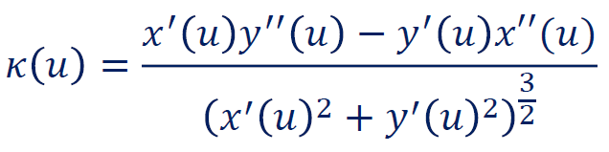
•
o
If we look at the curvature equation for a parametric curve, the curvature as a function of arc length will not in general be a polynomial.
This has the potential to introduce cusps（とがった先） or even discontinuities of the curvature in the spline, which makes it difficult to approximately satisfy curvature constraints across the entire domain of the spline.

Slide 10
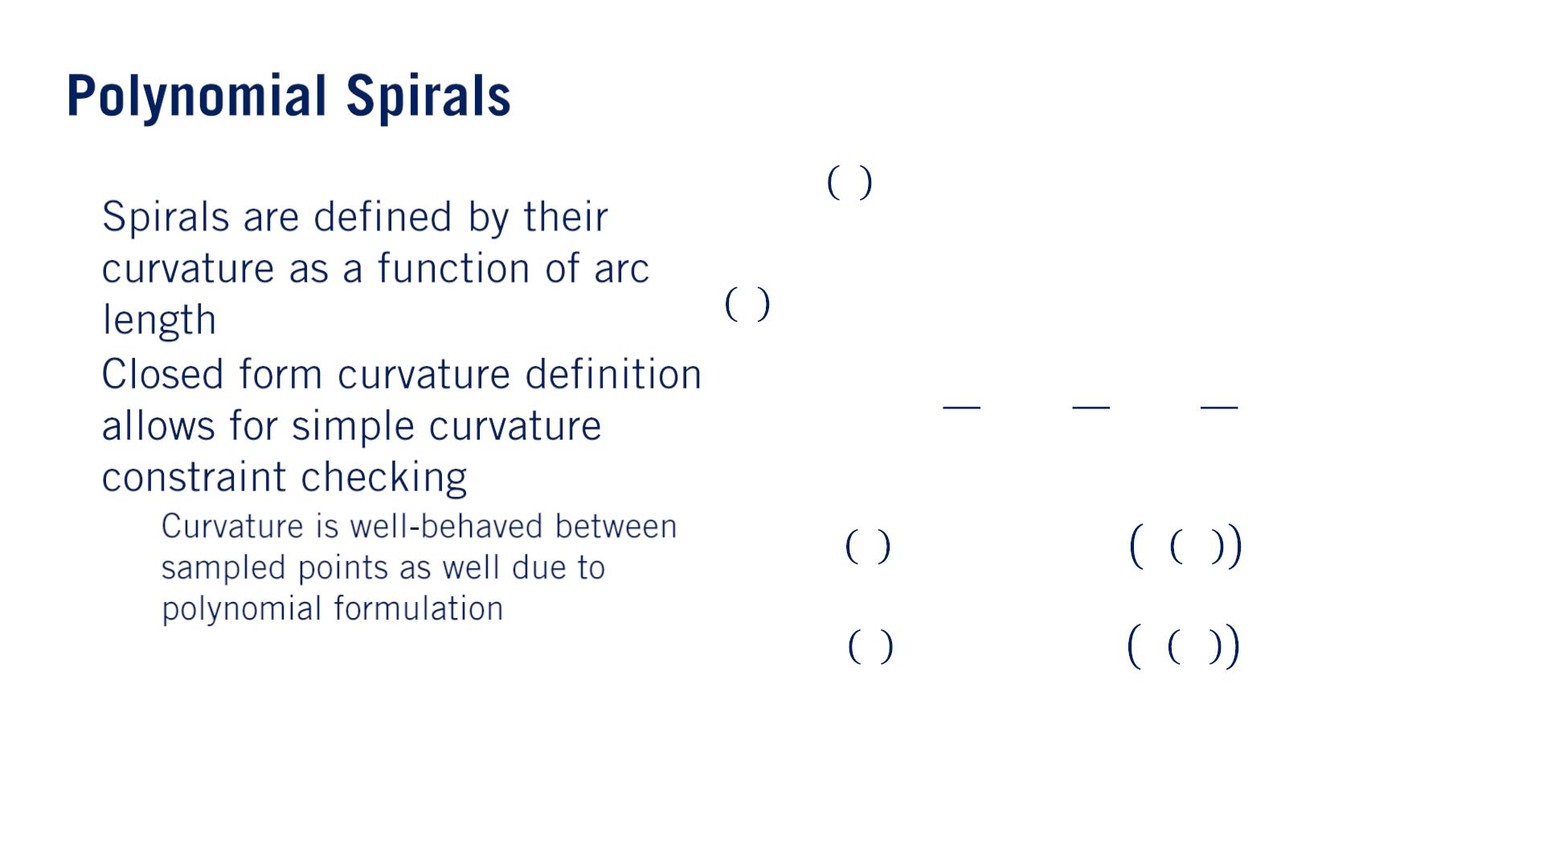
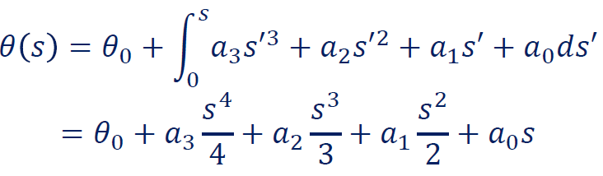
3
2
휅 푠 = 푎 푠 + 푎 푠 + 푎 푠 + 푎
•
•
3
2
1
0
푠
o
푥 푠 = 푥₀ + න cos 휃 푠′ 푑푠′
0
푠
푦 푠 = 푦₀ + න sin 휃 푠′ 푑푠′
0
Since a spiral is a polynomial function of curvature, the curvature value will not change extremely quickly like it can in the case of quintic splines.
This means we can constrain the curvature of only a few points in the spiral and the spiral will very likely satisfy the curvature constraints across the entire curve. This is highly useful when performing path optimization, as the number of constraints greatly increases the computational effort of each optimization step.

Slide 11
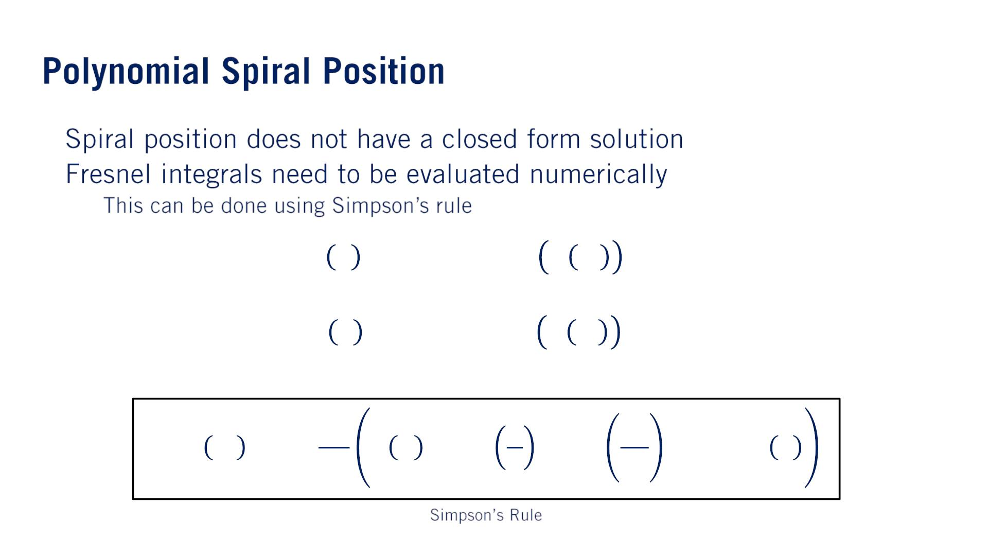
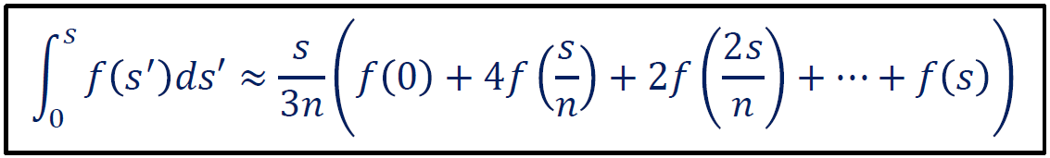
•
•
フレネル積分
No closed form solutionだから
o
푠
푥 푠 = 푥₀ + න cos 휃 푠′ 푑푠′
Simpson’s rule is more accurate with fewer points than other approximation methods, which will be useful when we setup our optimization problem.
0
푠
푦 푠 = 푦₀ + න sin 휃 푠′ 푑푠′
0

Slide 12
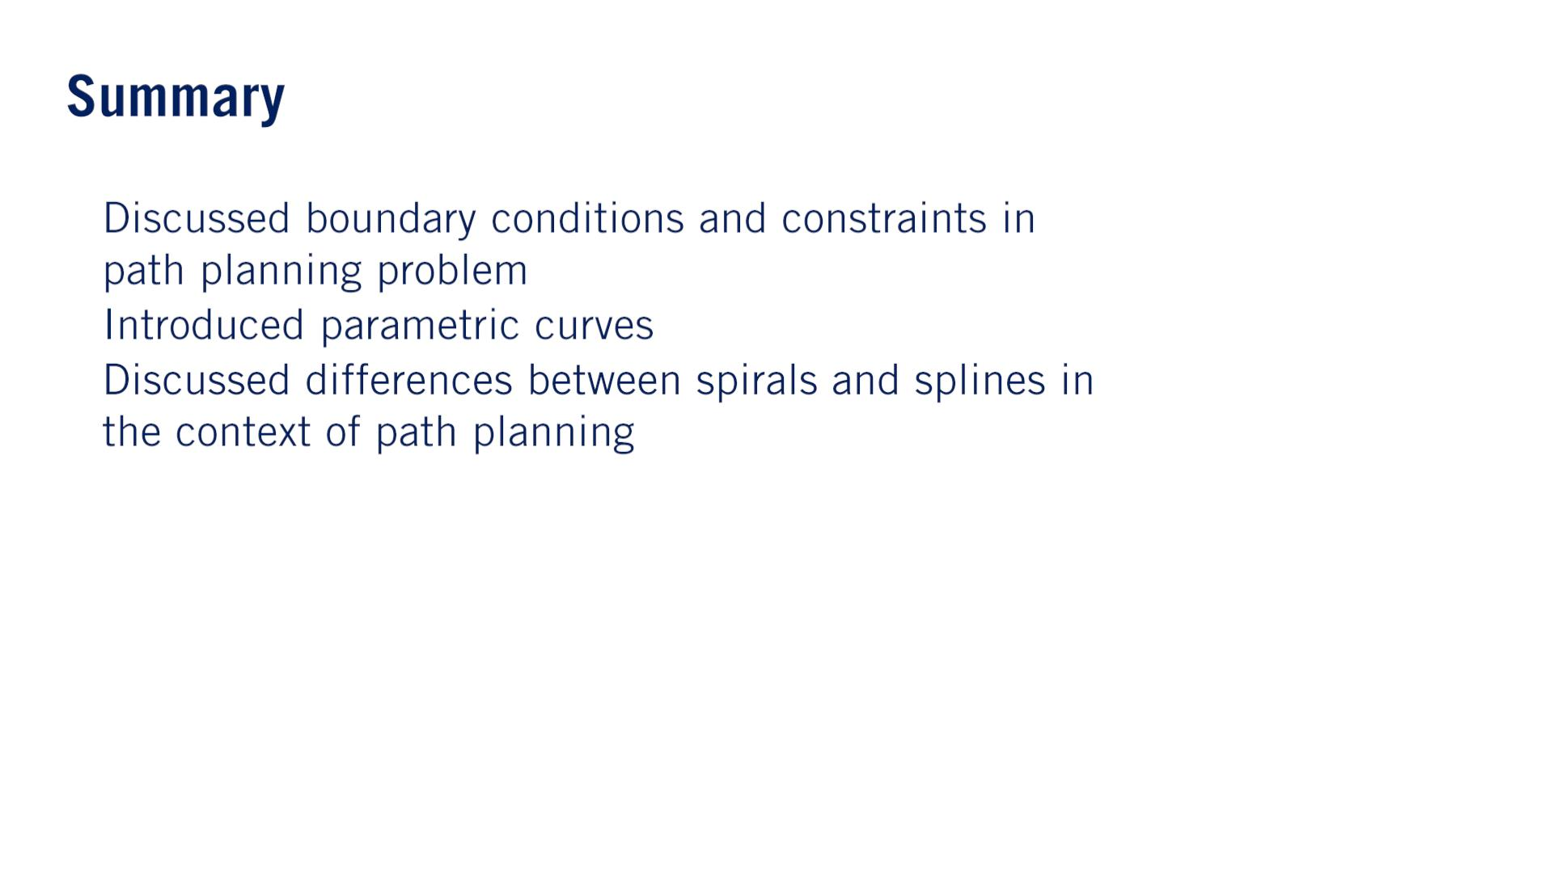
•
•
•
As a brief shorthand（速記「そっき」）, the spline leads to computational efficiency, while the spiral leads to easier implementation of curvature constraints.

Slide 13


Slide 14
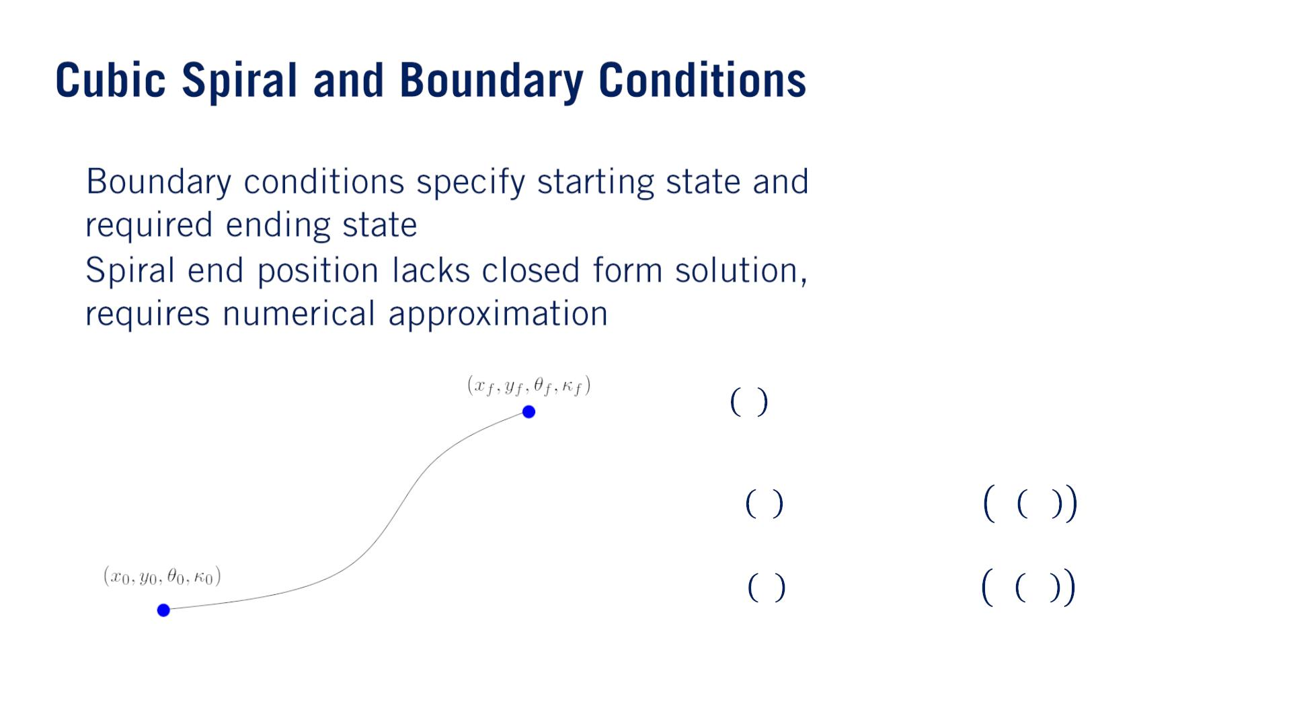
•
•
3
2
휅 푠 = 푎 푠 + 푎 푠 + 푎 푠 + 푎
3
2
1
0
푠
푥 푠 = 푥₀ + න cos 휃 푠′ 푑푠′
0
푠
푦 푠 = 푦₀ + න sin 휃 푠′ 푑푠′
0

Slide 15
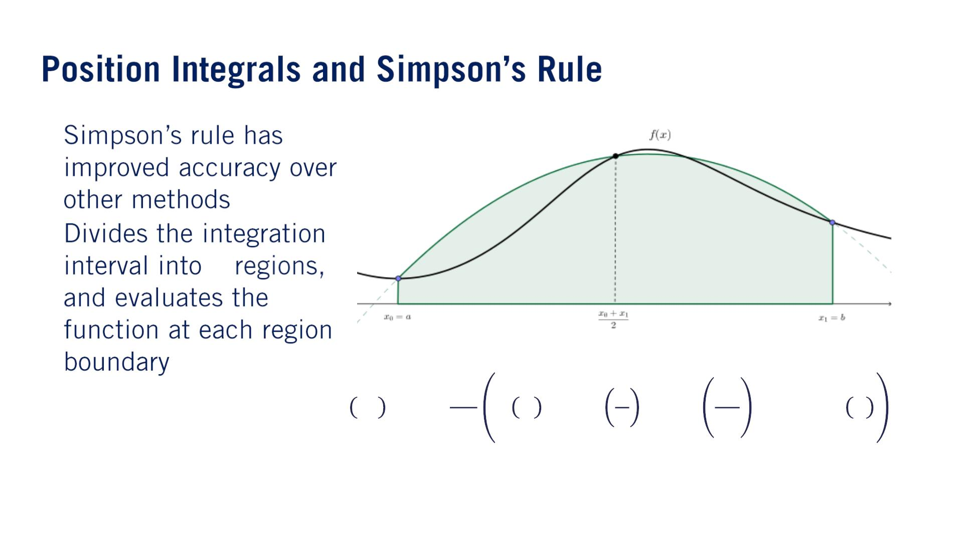
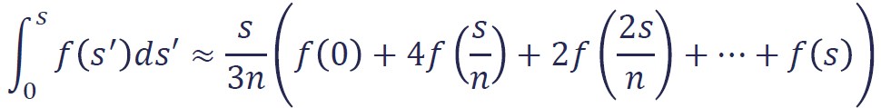
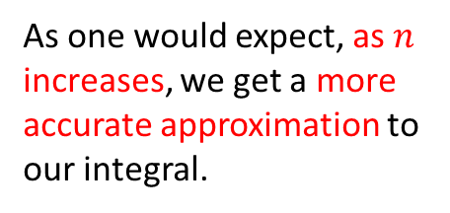
This is because it evaluates the integral of the quadratic（二次） interpolation of the given function rather than the integral of the linear interpolation as in some methods such as midpoint and trapezoidal rules.
•
•
푛
As one would expect, as $n$ increases, we get a more accurate approximation to our integral.

Slide 16
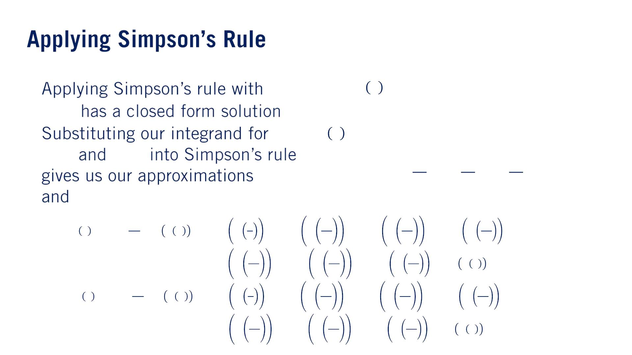
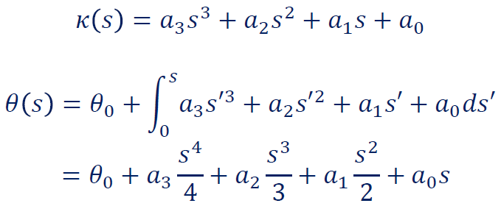
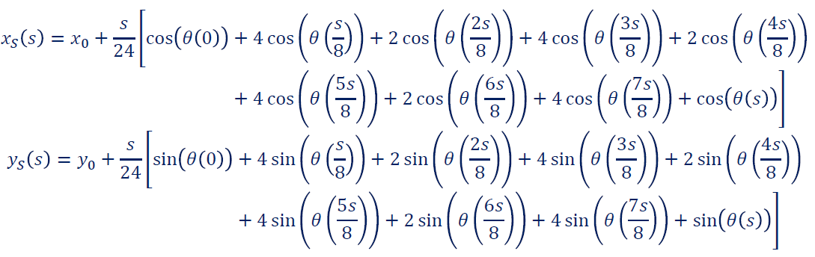
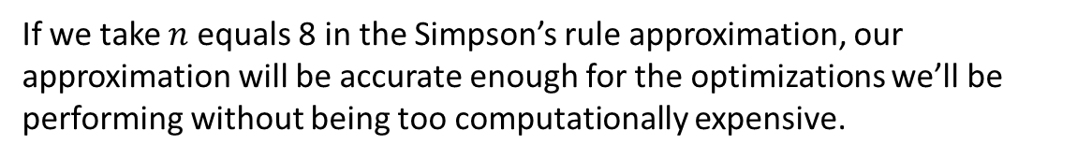
If we take $n$ equals 8 in the Simpson’s rule approximation, our approximation will be accurate enough for the optimizations we’ll be performing without being too computationally expensive.
•
푛 = 8
• 휃(푠)
•
푥(푠) 푦(푠)
^{푥}푆^{(푠)}
푦_{푆}(푠)

Slide 17
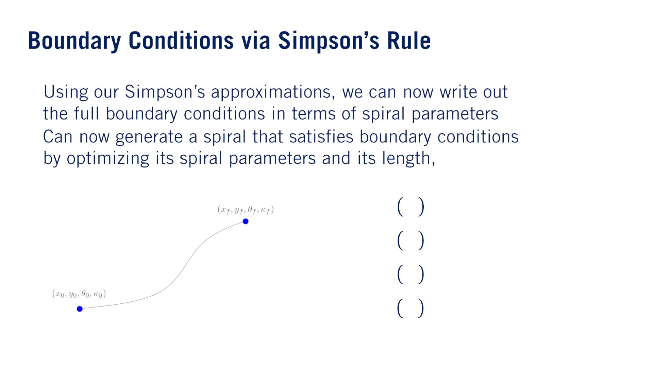
•
•
푠_{푓}
푥 푠 = 푥
푆 푓
푓
푦 푠 = 푦
푆 푓
푓
휃 푠_{푓} = 휃_{푓}
휅 푠_{푓} = 휅_{푓}

Slide 18
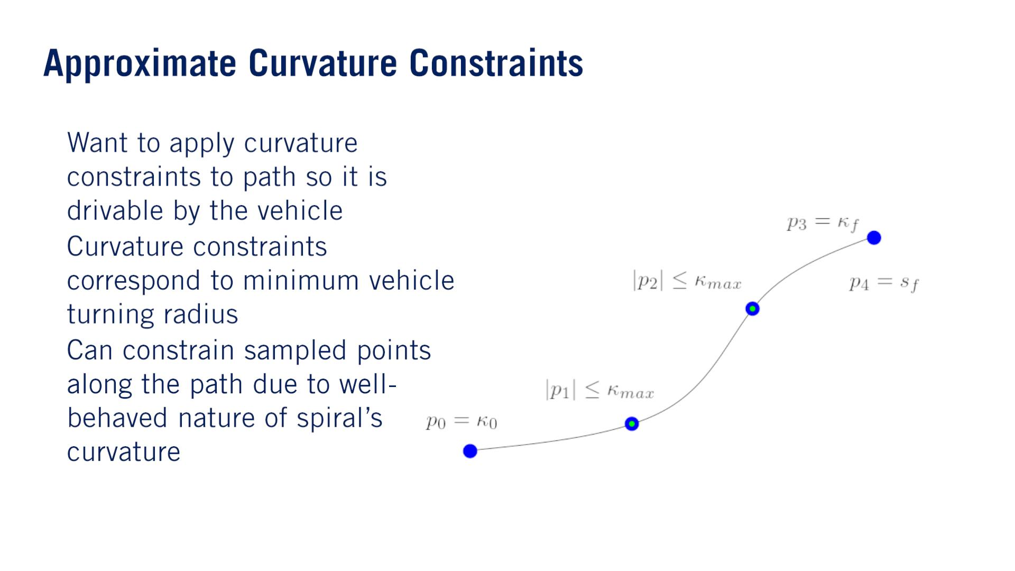
•
•
•

Slide 19
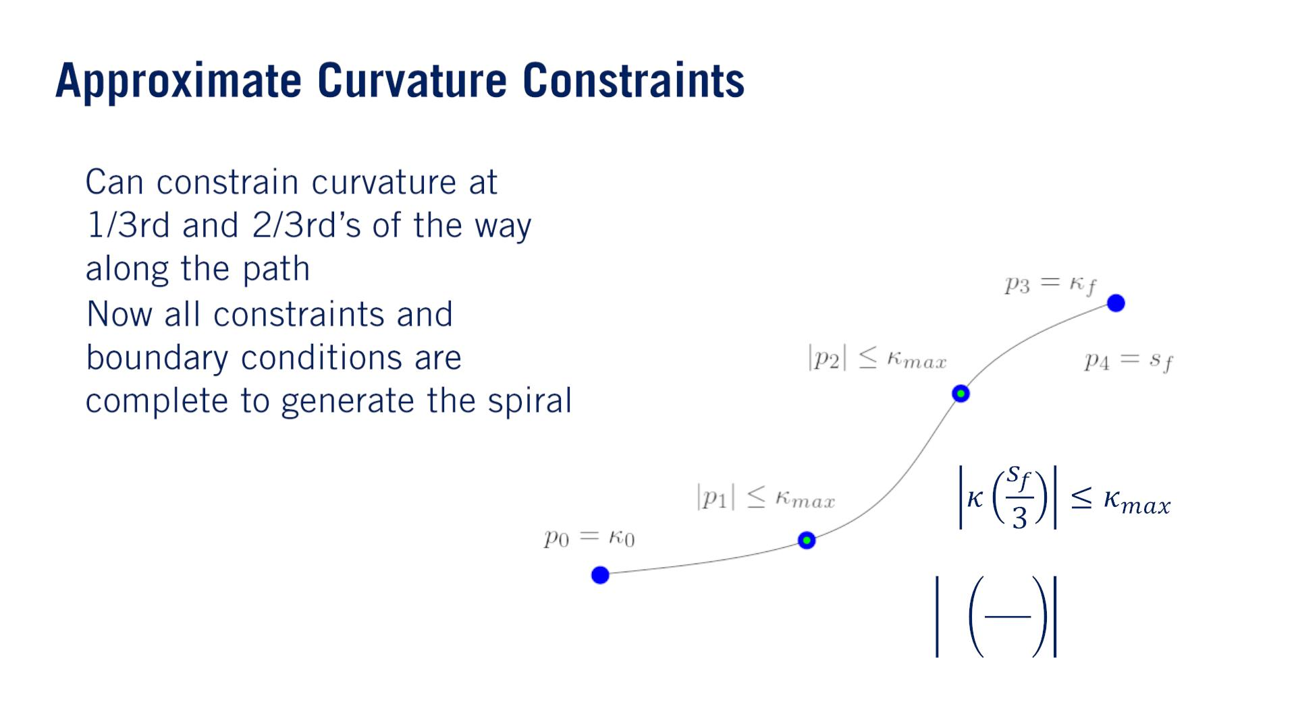
•
•
2푠_{푓}
휅
≤ 휅_{푚푎푥}
3

Slide 20
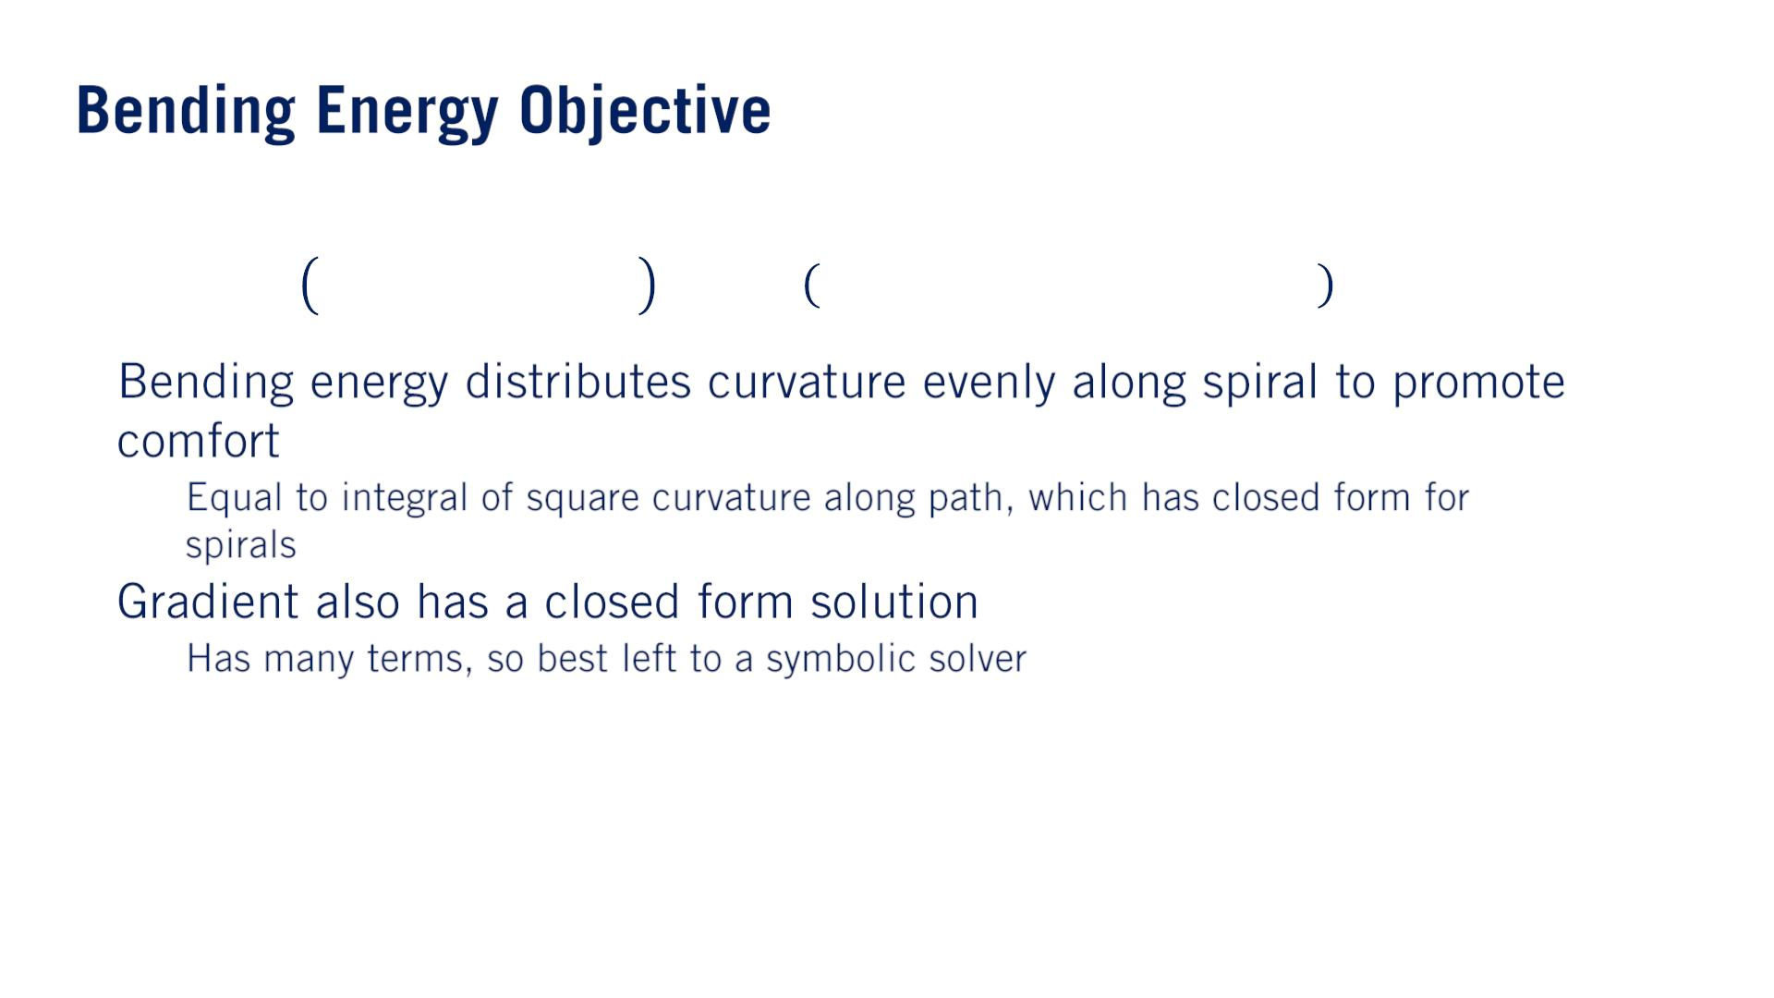
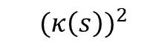
C4M1L3 Objective Functions for Autonomous Drivingご参考
$$(κ{\left(s\right))}^{2}$$
^{푠}푓
3
2
2
푓 푎 , 푎 , 푎 , 푎 , 푠 = න 푎 푠 + 푎 푠 + 푎 푠 + 푎 푑푠
푏푒 0 1 2 3 푓
3
2
1
0
曲げエネルギ
0
•
•
o
o
Polynomialの積分だから
Closed form solutionが存在するから、symbolic solverを使うんだ
シンボリックソルバー
数値ソルバー（解の近似値を返す） or シンボリックソルバー（厳密解を返す）：
https://jp.mathworks.com/help/symbolic/select-numeric-or-symbolic-solver.html
The fact that the objective function and its gradient have closed form solutions make it an objective function that is highly conducive to nonlinear programming which we will discuss in next lesson. Scipy.minimizeにobjective functionやJacobianが必要だから。

Slide 21
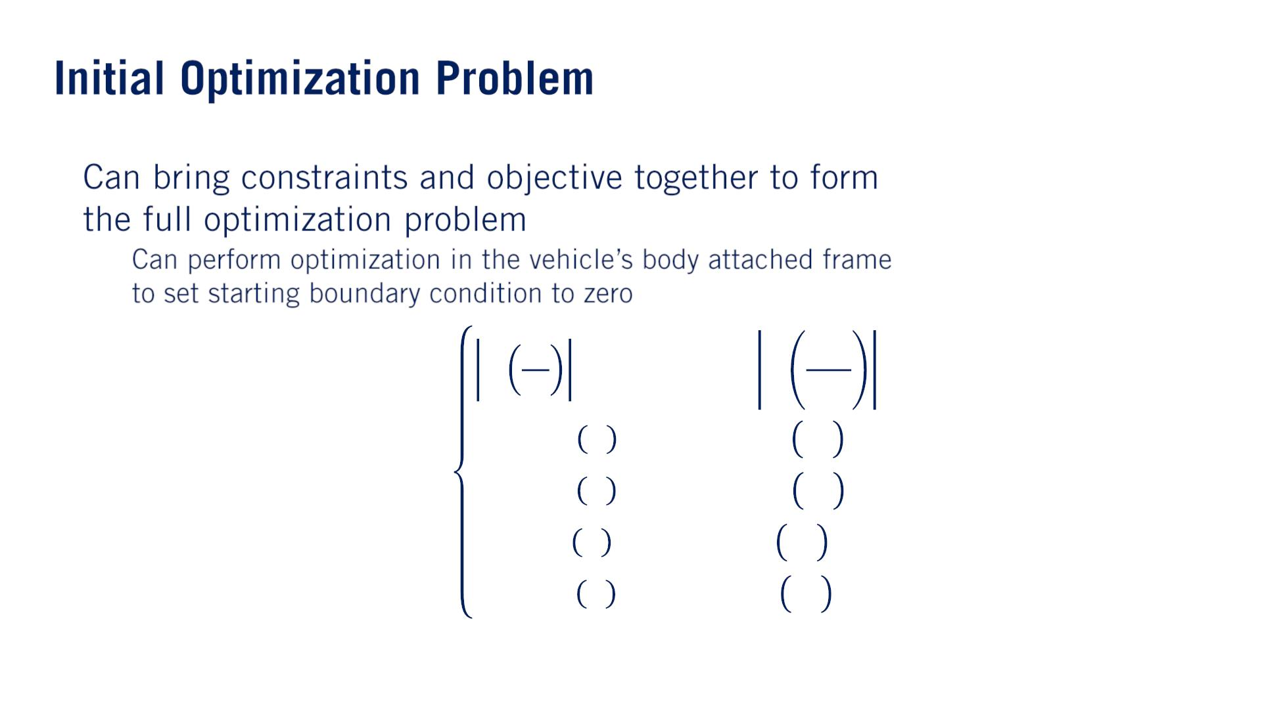
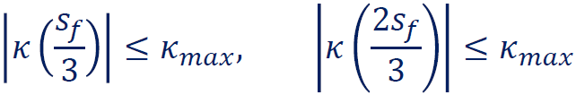
•
o
푥 0 = 푥 , 푥 푠 = 푥
푆
0
푠 푓
푓
min 푓 (푎 , 푎 , 푎 , 푎 , 푠 ) s. t.
シンプソン公式で表す
푏푒 0 1 2 3 푓
푦 0 = 푦 , 푦 푠 = 푦
푆
0
푆 푓
푓
휃 0 = 휃 , 휃 푠 = 휃
0
푓
푓
휅 0 = 휅 , 휅 푠 = 휅
0
푓
푓
Now we could very well stop here and use this as our path generating optimization problem. However, there is a practical issue with how this optimization problem is set up that may slow it down or cause it not to converge at all when solved using canonical（正統な、基準の） non-linear programming solvers.

Slide 22
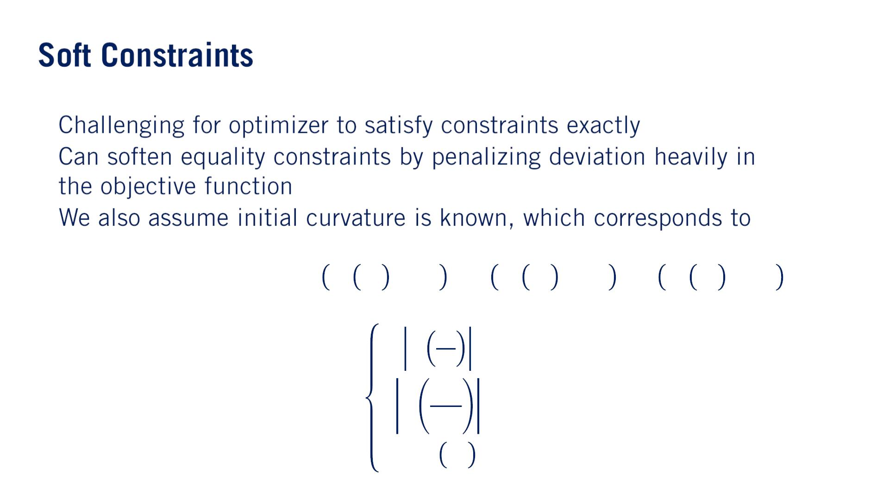
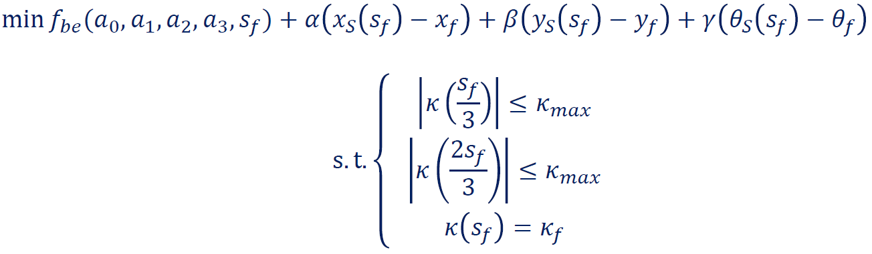
The main issue we can see here has to do with the equality constraints of the final position and heading. Because equality constraints must be satisfied exactly, it is quite hard for a numerical optimizer to generate a feasible solution from an infeasible starting point which is often what is given to the optimizer for an arbitrary problem instance.
•
•
•
푎₀
シンプソン公式で表す
Although this allows the optimizer to violate the boundary condition equality constraints, the optimizer will be strongly encouraged to converge a solution that is as close as possible to the boundary conditions before the bending energy penalty term will be large enough to influence the optimizer.
By heavily penalized, we mean that the constraint penalty term coefficient should be at least an order of magnitude larger than the general optimization objective. General optimization objectiveはbending energyの値だろう

Slide 23
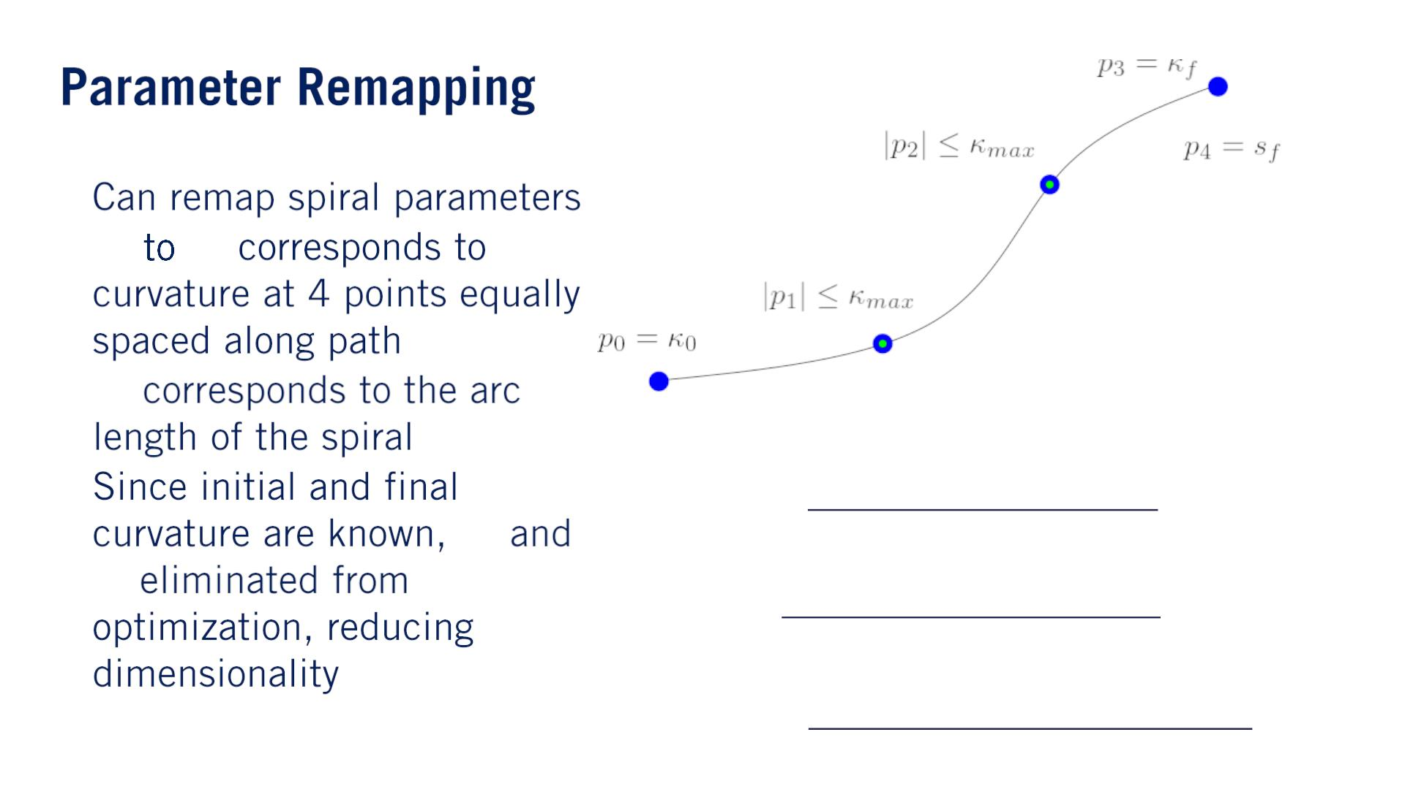
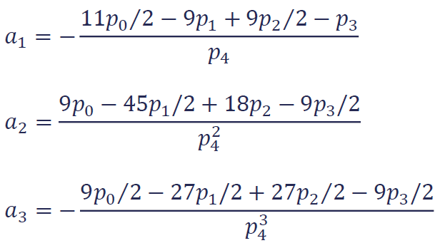
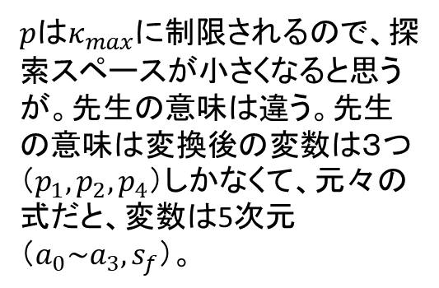
While there is more intuition to using the cubic spiral coefficients in our objective function, we can actually reduce the number of parameters we are searching over by taking the final curvature boundary constraint into consideration.
•
$pはκ_{max}$に制限されるので、探索スペースが小さくなると思うが。先生の意味は違う。先生の意味は変換後の変数は３つ（$p_{1}, p_{2}, p_{4}$）しかなくて、元々の式だと、変数は5次元（$a_{0}\sim a_{3}, s_{f}$）。
• 푝₀ 푝₃
• 푝₄
•
푎₀ = 푝₀
푝₀
^{푝}3

Slide 24
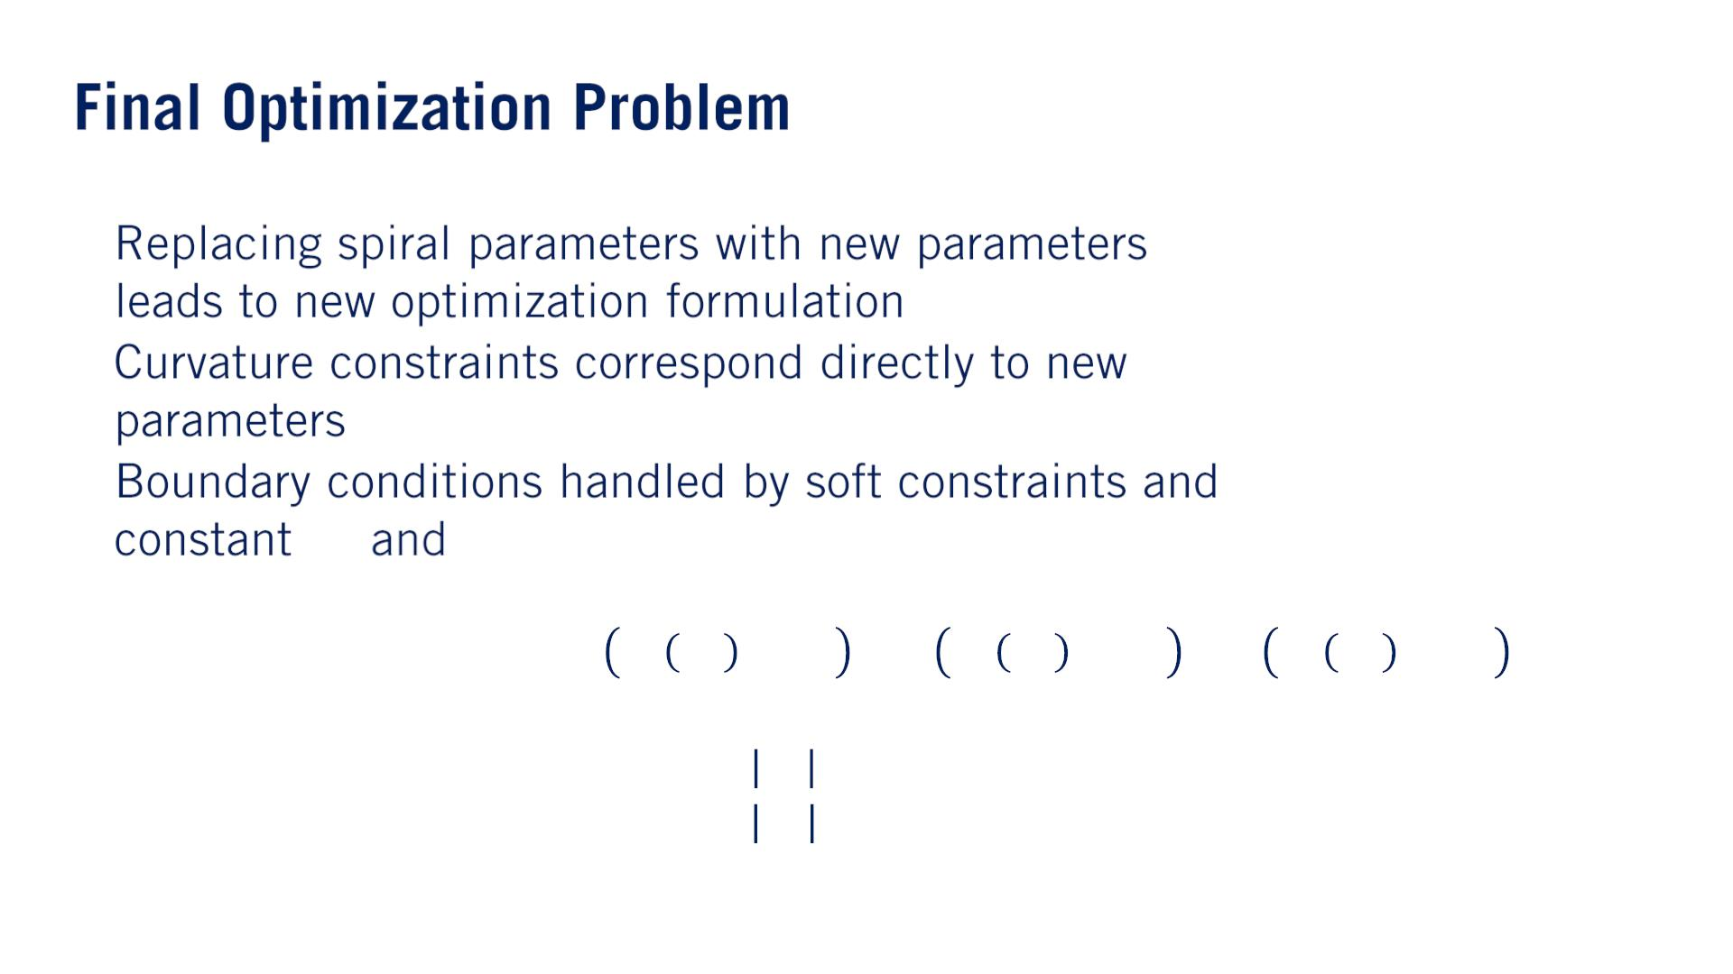
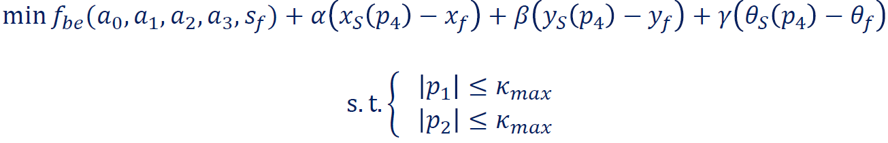
•
•
•
푝₀
푝₃

Slide 25
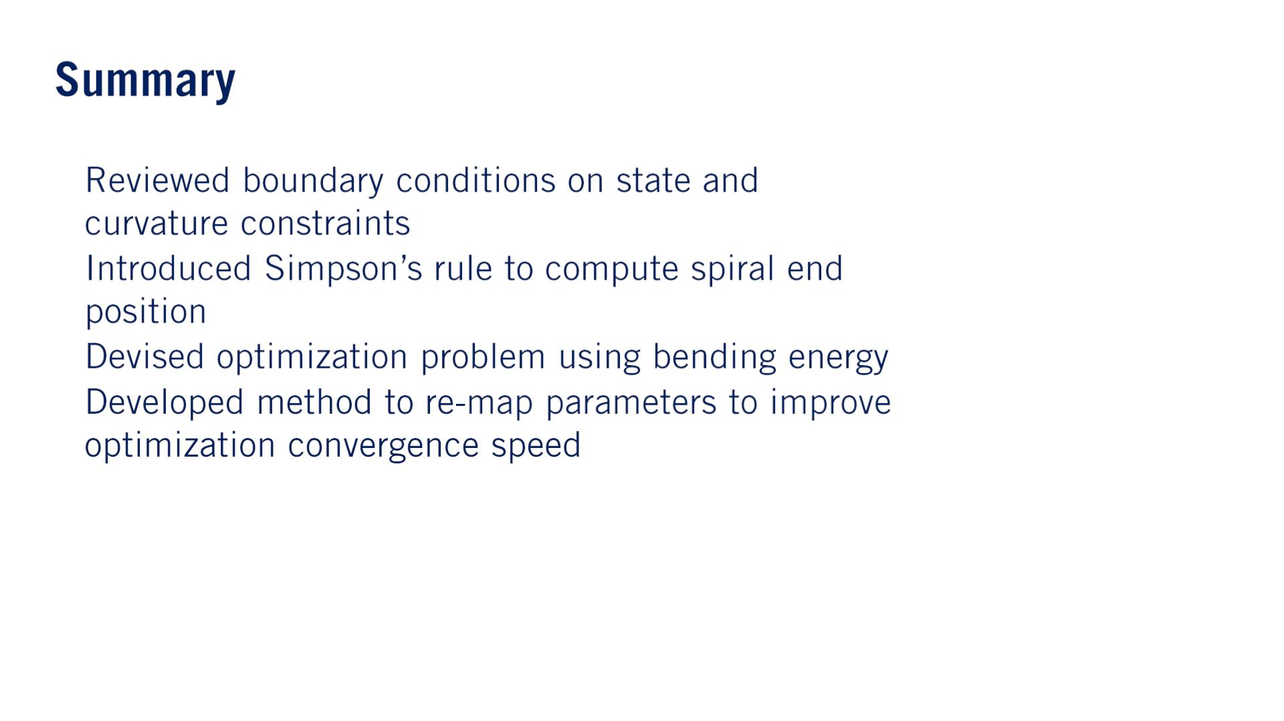
•
•
•
•

Slide 26


Slide 27
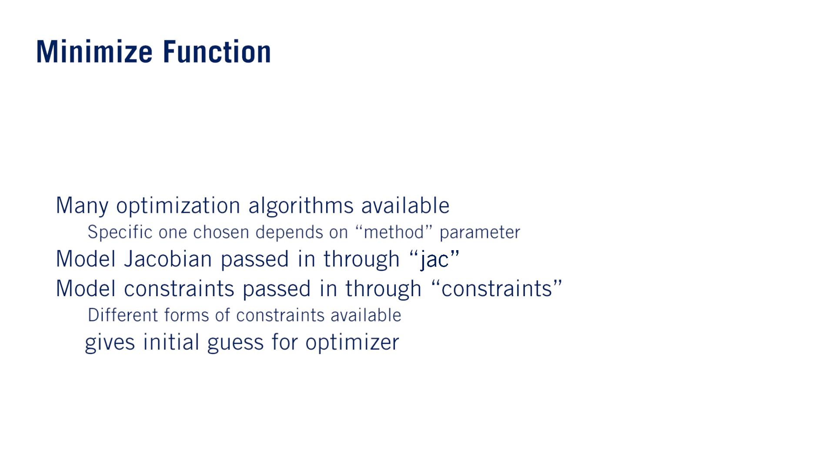
result = sp.minimize(objective_function, x_0, method='L-BFGS-B',
jac=objective_jacobian, bounds=bounds,
options={'disp' : True})
•
o
o
•
•
• 푥₀

Slide 28
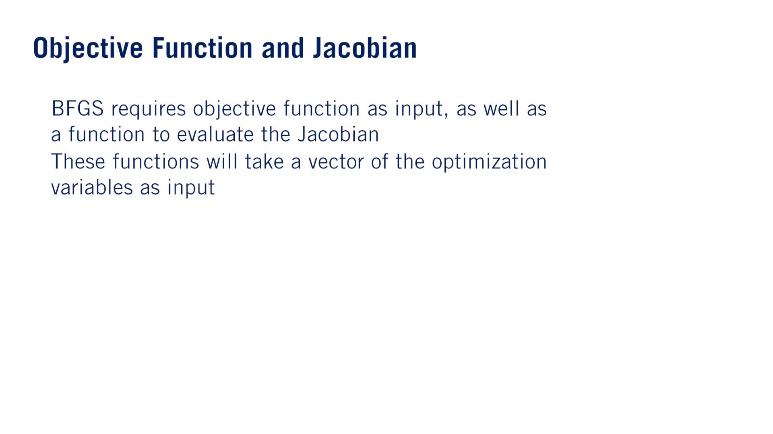
•
•
def objective_function(x):
return x[0]**2 + 4*x[0]*x[1]
def objective_jacobian(x):
return np.array([2*x[0] + 4*x[1], 4*x[0]])

Slide 29
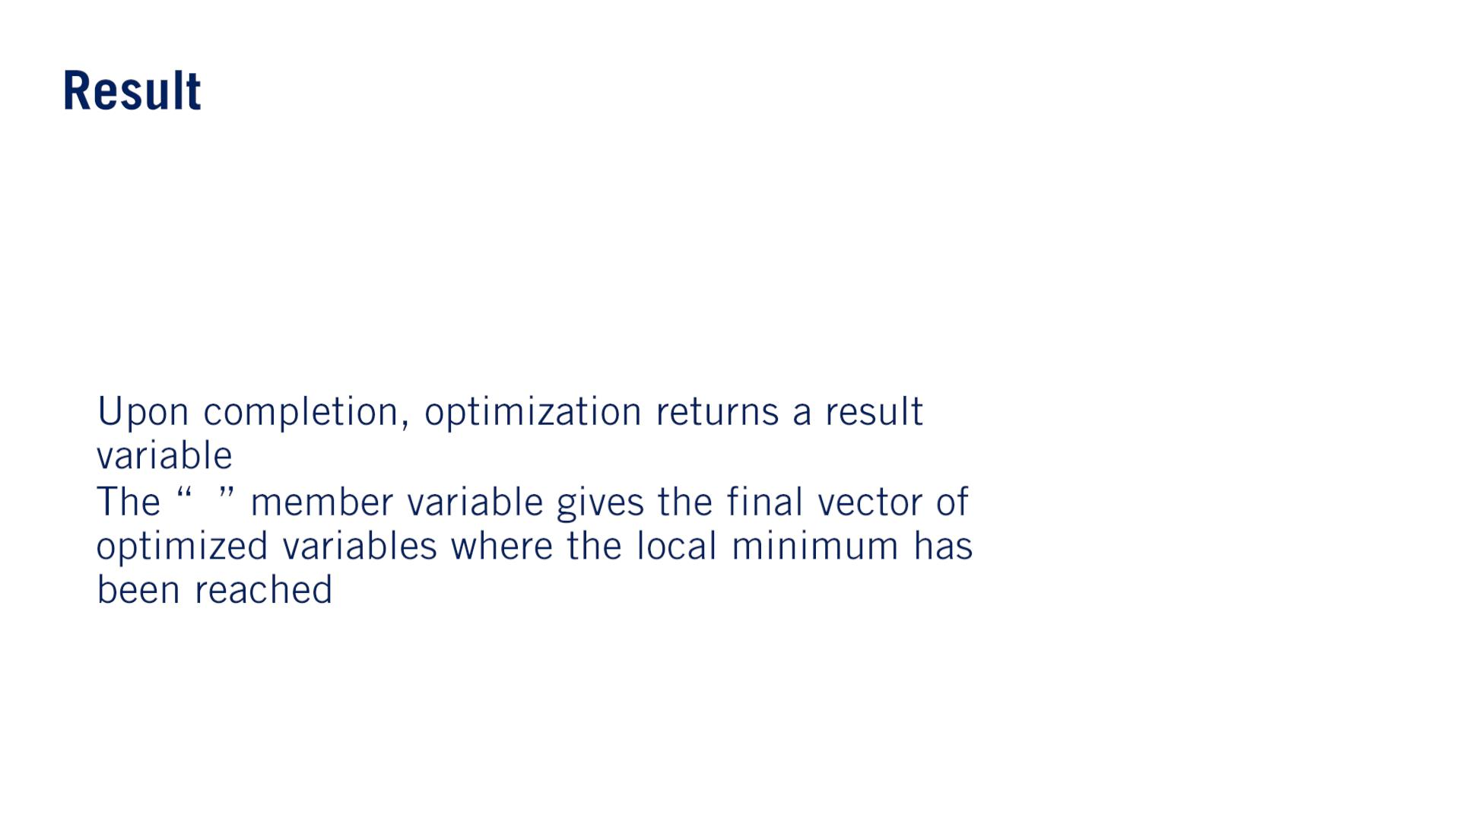
result = sp.minimize(objective_function, x_0, method='L-BFGS-B',
jac=objective_jacobian, bounds=bounds,
options={'disp' : True})
print(result.x)
•
•
푥

Slide 30
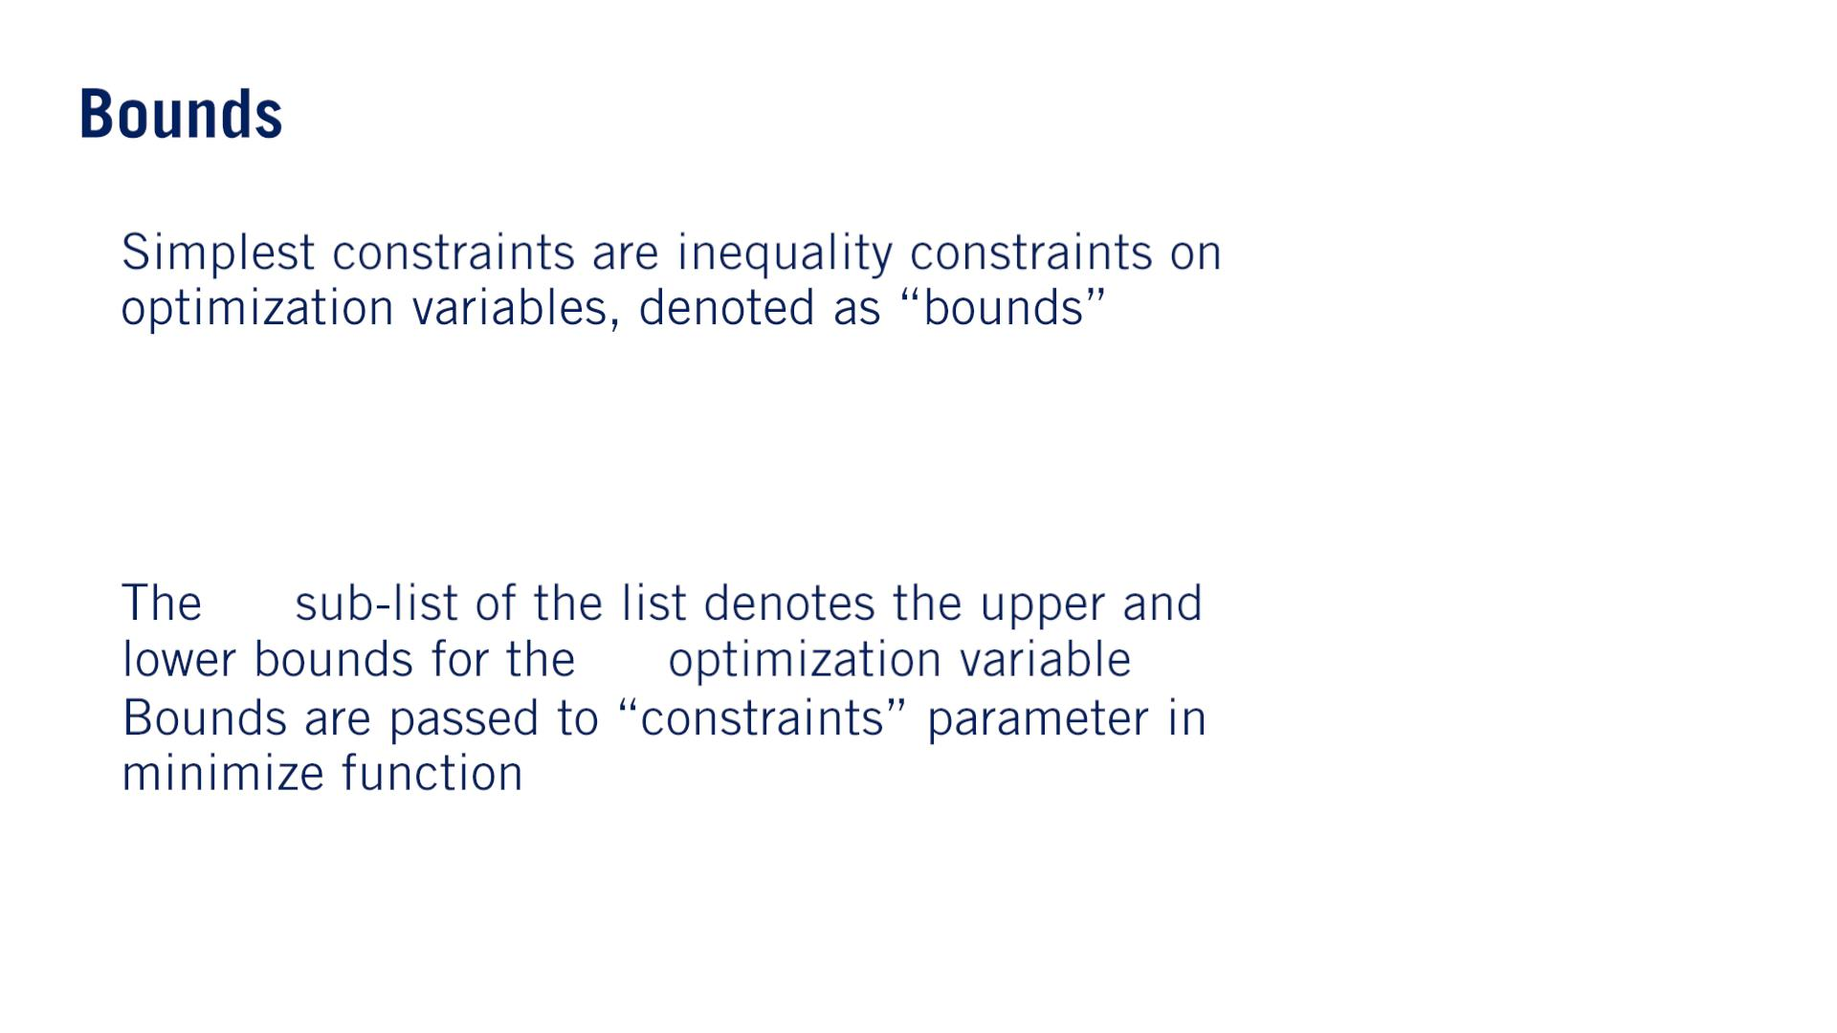
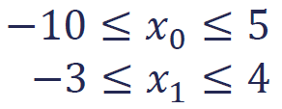
不等式制約
•
bounds = [[-10.0, 5.0], [-3.0, 4.0]]
•
•
푖^{푡ℎ}
_{푖}푡ℎ

Slide 31
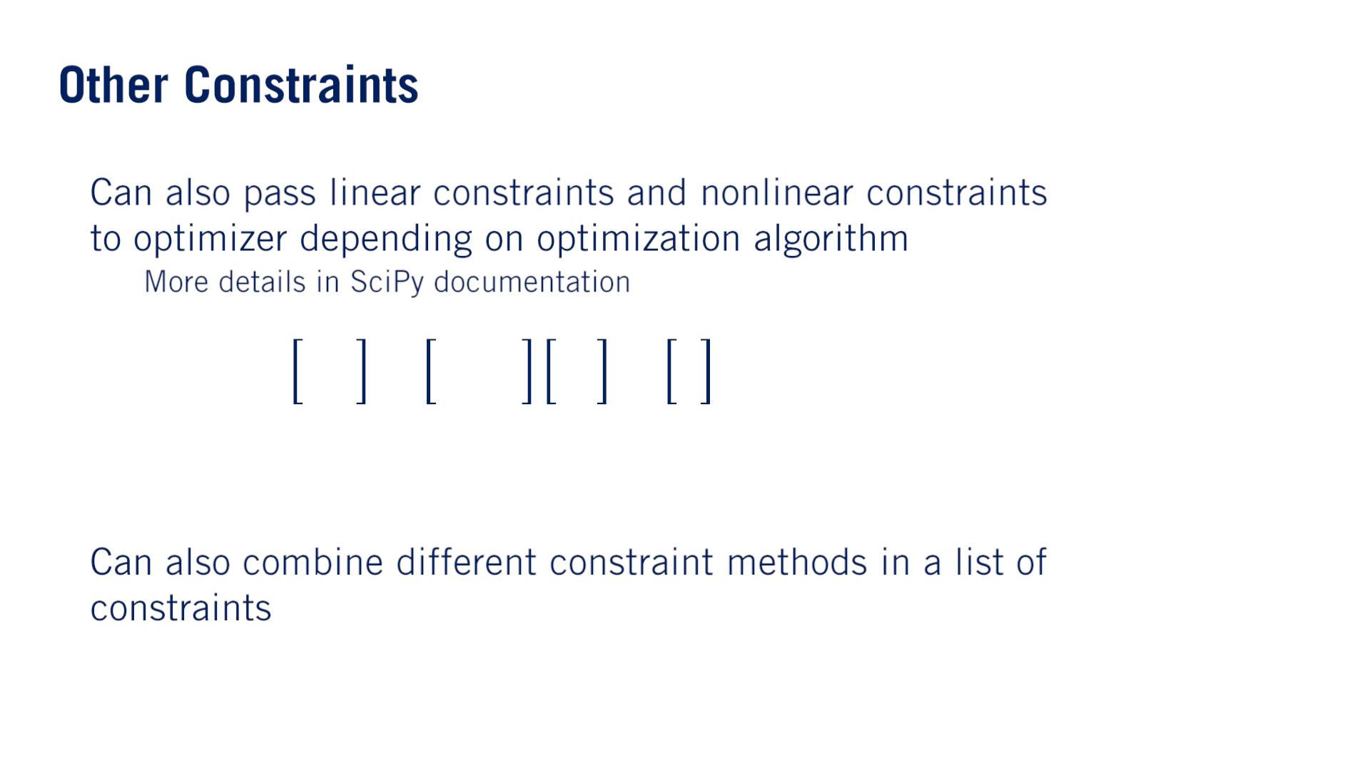
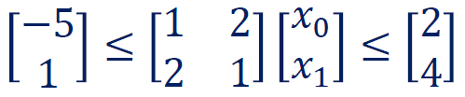
•
•
o
linear_constraint = LinearConstraint([[1, 2], [2, 1]], [2, 4])

Slide 32
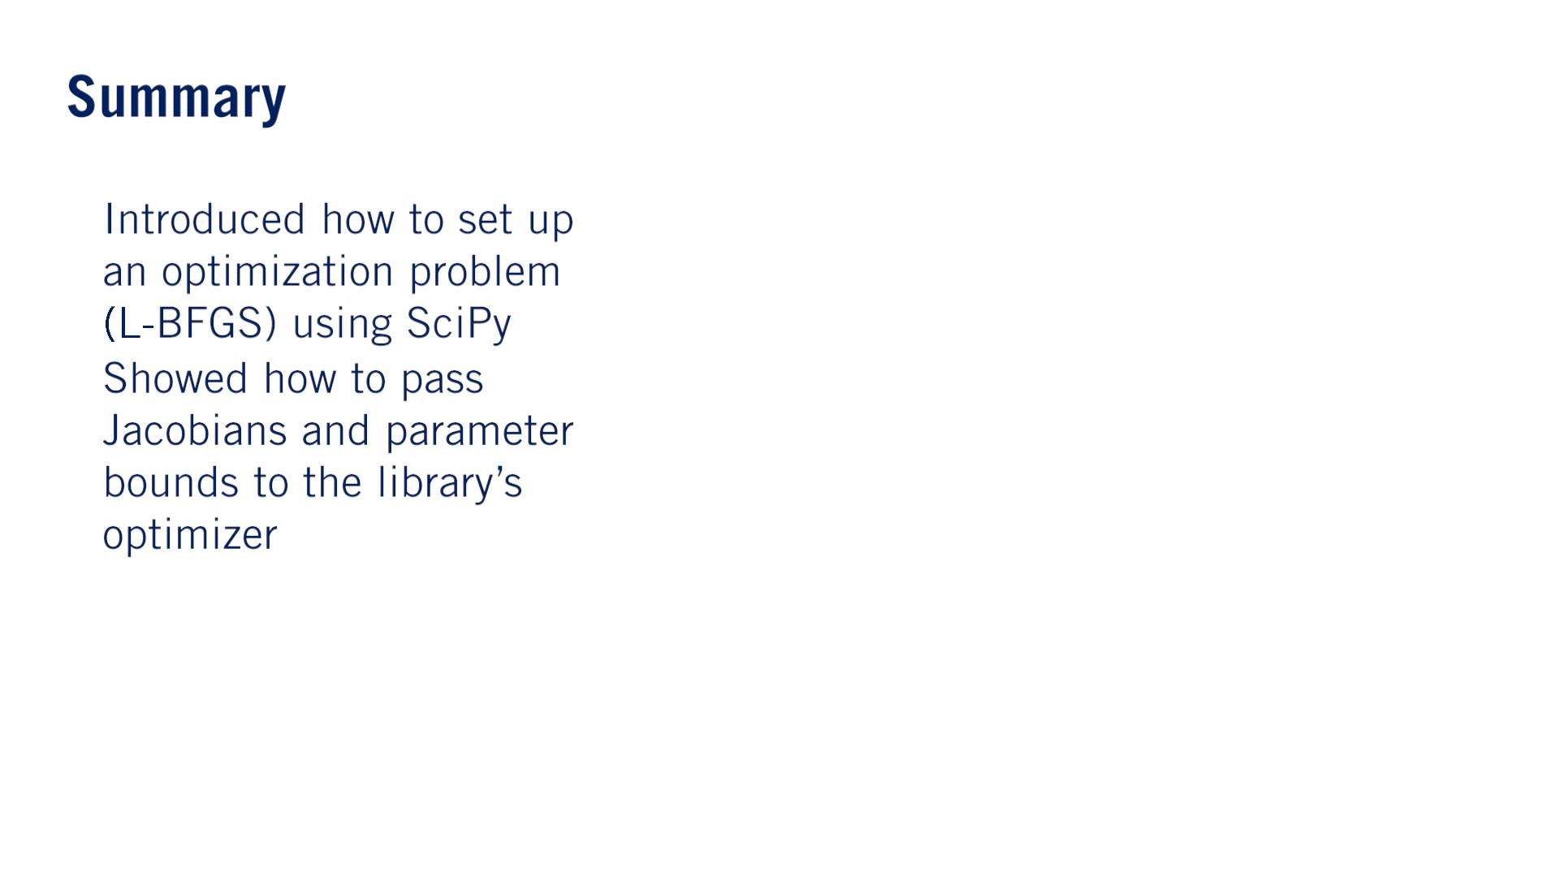
#nlopt
import scipy.optimize as sp
import numpy as np
•
•
bounds = [[-10.0, 5.0], [-3.0, 4.0]]
x_0 = [1.0, 1.0]
linear_constraint = LinearConstraint([[1, 2],
[2, 1]], [2, 4])
def objective_function(x):
return x[0]**2 + 4*x[0]*x[1]
def objective_jacobian(x):
return np.array([2*x[0] + 4*x[1], 4*x[0]])
result = sp.minimize(objective_function, x_0,
method='L-BFGS-B', jac=objective_jacobian,
bounds=bounds, options={'disp' : True})
print(result.x)
Solution:
>>> [-8. 4.]

Slide 33


Slide 34
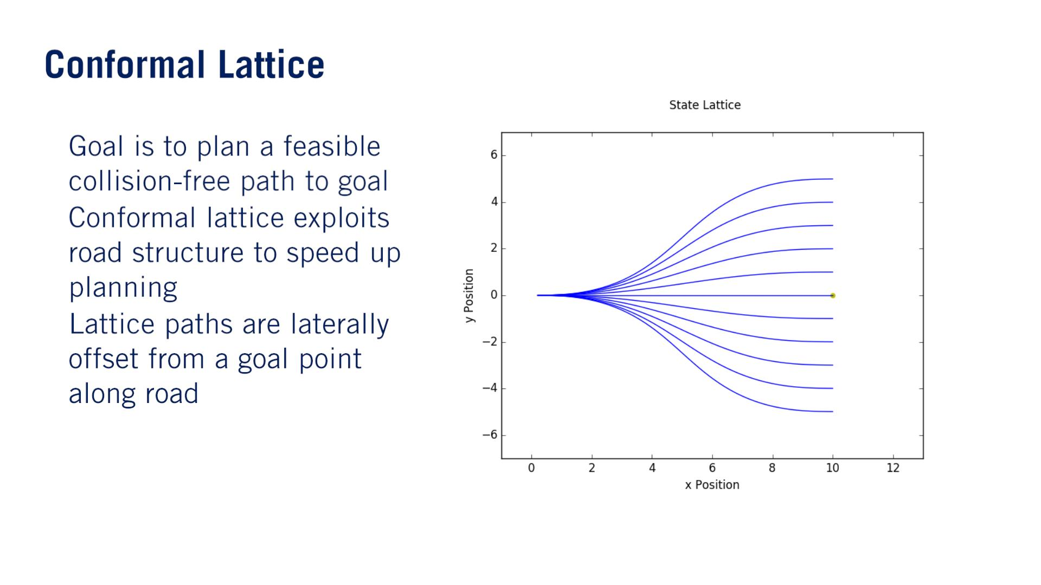
By focusing on only those smooth path options that swerve（（真っすぐな進行方向から急に）それる） slightly to the left and right of the goal path, the conformal lattice planner produces plans that closely resemble human driving.
•
•
•

Slide 35
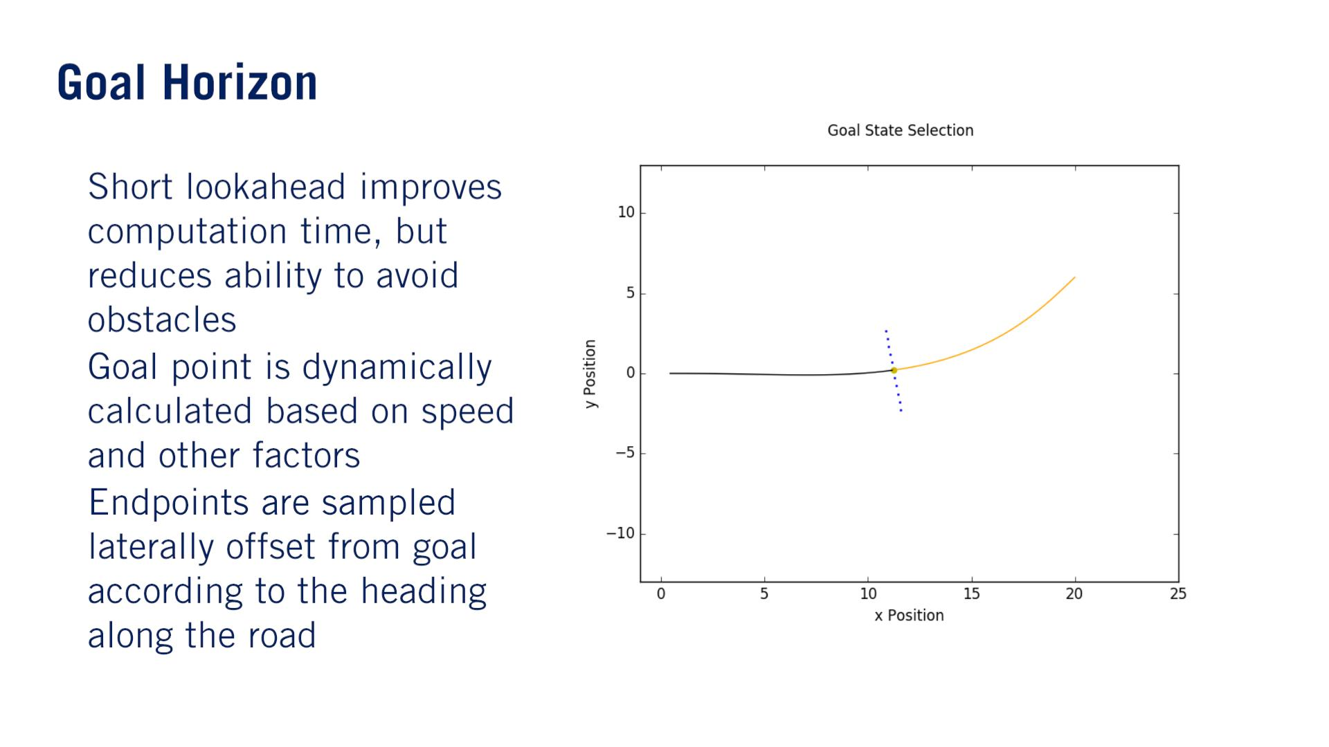
•
•
•

Slide 36



•
•
•
この最小化問題の結果は最適$のp_{1}, p_{2}, p_{4}$。

Slide 37



•
•
^{푎}0 ^{= 푝}
0
Sample pointsはパスとして利用すると思う。でも$θ(s)$まで簡単に計算できるが、$x\left(s\right), y(s)$は積分する必要がある。

Slide 38


Since we don’t have a closed form solution of the position along the spiral, we again need to perform numerical integration. However, since this time, we are evaluating the integral in numerous points along the entire spiral, a more efficient method is needed to solve these integrals.
台形公式
シンプソン公式のほうが精度が良いが、台形公式のほうが計算早い。
シンプソン公式は境界条件を表すのみ。
台形公式はパス点列を計算する。
•
•
Linear interpolation
•
The trapezoid rule is significantly more efficient than Simpson’s rule in this context, because each subsequent point along the curve, can be constructed from the previous one. So we only have to do one sweep through the spiral to get all of the required points.
だから関数名がcumulative（累計）だ

Slide 39

•
•
•

Slide 40

•
•

Slide 41

•
•
•
•

Slide 42

•
•
Similar to the reactive planner we developed in module 4, this planner proceeds in a receding horizon fashion towards the goal at the end of the lane.

Slide 43

•
•
•

Slide 44

If you recall from Module 1, there are many factors that affect velocity profile generation. In particular, we will focus on the reference velocity provided by the behavior planner, the velocity of dynamic obstacles in front of us, and the velocity required to maintain passenger comfort and vehicle stability.

Slide 45

The first step in generating a velocity profile is determining our final required velocity. ここのreference velocityはfinal required velocityとして理解したほうが簡単だと思う。
•
•
•
o

Slide 46


•
•
•

Slide 47



However, if the curvature changes rapidly, we may not be able to achieve the required velocity while remaining within our longitudinal acceleration bounds. We therefore also find the maximum curvature across all points in out path and then find the associated maximum speed for that point.
•
•
κ_{푖}
Our profile must then reach this required speed by the point in the path. We therefore define a deceleration to the required speed at the minimum point and an acceleration afterward.
•
We can repeat this process for the next largest violation of the curvature constraint（上記の1回減速1回加速で計画したプロフィールに速度違反がある箇所） and so on until the velocity profile satisfies the curvature constraints along its length.
^{푎}푙푎푡
푣_{푘} ≤
푣 = min 푣 , 푣 , 푣
휅_{푖}
푓
푟푒푓 푙푒푎푑 푘
復習：$a_{lat}=\frac{v^{2}}{r}$
$v_{k}$はカーブが一番きつい箇所の速度制限

Slide 48

•
•
푠
푣₀ 푣_{푓}
加速度固定なら、絶対この形じゃないだろう。

Slide 49


•
•
o
If an acceleration or deceleration is required that exceeds the comfort rectangle but is required due to safety concerns, such as during an emergency stop maneuver, then we can bypass this comfort rectangle to prevent a crash.
푎
2
2푎푠 + 푣 = 푣
0
푓

Slide 50

•
푠_{푖}
2
2푎푠 + 푣 = 푣
푖
0
푓_{푖}

Slide 51

•
•
o

Slide 52


•
•
푣_{푡}
푎₀
$v_{0}^{2}$のはず、また固定減速度なので、決して右のような直線ではないと思う。

Slide 53


•
푣_{푡}
푎₀
•
•
푠_{푏}
푣_{푡}

Slide 54



Using higher-order methods such as biquadratic（4乗、4次） velocity planners, we can minimize jerk along the trajectory as well.
•
どうして$v_{i}$を使う（$i$はinitial…）？また、プロフィールは右のような直線ではないと思う。

Slide 55

•
•
•
•

